Slide 1
School District Wellness Policies: Where do they Stand and What do you Need to Know?
A Presentation to Accompany the May, 2014 CDC and Bridging the Gap Local School Wellness Policy Briefs
July, 2014

Slide 2
Presentation Purpose
Accompany CDC and Bridging the Gap (BTG) local school wellness policy research briefs
Contains content pulled directly from briefs
Serve as a communications tool for stakeholders
Entire slide set
Specific topic area slide set(s)
Specific slide(s)/chart(s)/figure(s)
Aid stakeholders in presenting content from briefs in a meaningful and impactful way
Notes:
Narrative:
This presentation was created to accompany the series of local school wellness policy research briefs developed jointly by the CDC and the Bridging the Gap Research Program and released in June, 2014. This slide set contains content, data, and figures pulled directly from each of the 7 topic area briefs, as well as the methods document. Therefore, it provides a substantive overview of the entire research brief series and can be used by a broad range of stakeholders to present the research findings, recommendations, resources and other information contained within the briefs in a meaningful way.
This slide set was designed to be presented in its entirety, by individual section(s) (research brief topic area), or by individual slide. Presenters have the rights and capability to download and use all slides contained in this set or to extract individual slide(s), depending upon their needs and audience.

Slide 3
Suggested Presentation Citation
For slides, Content and/or figures from this Slide set:
Centers for Disease Control and Prevention and Bridging the Gap Research Program. School District Wellness Policies: Where do they Stand and What do you Need to Know?: A Presentation to Accompany the May, 2014 CDC and Bridging the Gap Local School Wellness Policy Briefs. 2014. Available at: http://www.cdc.gov/healthyyouth/npao/wellness.htm http://www.bridgingthegapresearch.org/research/district_wellness_policies/.
Notes:
Narrative:
Please use this citation for all content obtained from this slide deck.

Slide 4
CDC & Bridging the Gap Local Wellness Policy Briefs
Developed by CDC and BTG to help stakeholders
Strengthen existing policies
Implement new policies
Understand where wellness policies are well established and where opportunities exist
7 topic areas + methods document
3 four-page briefs
4 two-page fact sheets
Available on CDC and BTG websites
http://www.cdc.gov/healthyyouth/npao/wellness.htm
http://www.bridgingthegapresearch.org/research/district_wellness_policies/
Notes:
Narrative:
CDC and the Robert Wood Johnson Foundation’s Bridging the Gap research program developed a series of research briefs highlighting opportunities to support wellness policies through evidence-based strategies.
The brief series covers seven topic areas related to the school health environment, as well as a methods document
The local wellness policy briefs focus on broad, well-established areas of the school health and wellness environment for which robust data is available.
To supplement the policy briefs, the CDC and BTG also developed a series of four fact sheets, which focus on narrower topic areas for which there is not a lot of data, but that still play a significant role in creating a healthy school environment.
These briefs provide an assessment of policies across school districts nationwide.
They also provide state agencies, school districts, and schools with recommendations and resources from leading school health authorities to help strengthen wellness policy components

Slide 5
Slideshow Content Organization
Each topic area contains
Background information
Health impact
Current recommendations
Actions (results)
Strategies and expert recommendations
Resources from CDC, USDA, Action for Healthy Kids (AFHK), and others
References to literature
Notes:
Narrative:
The following slide sets accompany each of the published briefs. For each topic area of this presentation, the following content has been pulled from the briefs themselves:
Background information about the specific wellness policy topic area, including health impacts and established recommendations from leading health authorities with regard to the topic area
Actions (results) – Data derived from the 2011-12 school year, outlining the actions school districts have taken with regard to a specific wellness policy component
Expert recommendations and evidence-based strategies to help improve school wellness with regard to the given topic area
Resources and tools from reputable authorities, including the CDC, USDA, and Action for Healthy Kids to assist stakeholders in creating a healthier school environment
References to the literature cited throughout the slide deck for each topic area
references

Slide 6
Methods Document for the CDC and Bridging the Gap Local School Wellness Policy Briefs
July, 2014
Suggested citation: Bridging the Gap Research Program. Methods Document for the CDC and Bridging the Gap Local School Wellness Policy Briefs. Available at: http://www.cdc.gov/healthyyouth/policy/pdf/methodsforwellnesspolicybriefs.pdf.
Notes:
Narrative:
The next several slides will describe the methods document that was developed to accompany the wellness policy brief series.

Slide 7
Methods Brief Overview
Purpose
Provide a methodological overview for the entire series of CDC and BTG briefs
Background
Federal wellness policy mandate
Child Nutrition and WIC Reauthorization Act of 2004¹
Healthy, Hunger-Free Kids Act of 2010²
Bridging the Gap (BTG) program
Largest, ongoing nationwide evaluation of the district wellness policy progress and opportunities
School year (SY) 2006-07 through 2011-12 (for these briefs)
Collection continued through the current school year
Includes concomitant state laws
Notes:
Narrative:
CDC and Bridging the Gap created a methods brief to accompany the seven topic area briefs. The purpose of this document is to provide a methodological overview for the entire series of briefs, including sample design, policy collection and coding, and data analysis.
The Child Nutrition and WIC Reauthorization Act of 2004¹ and, more recently, the Healthy, Hunger-Free Kids Act of 2010² required all school districts participating in the federal Child Nutrition Programs to adopt and implement a local school wellness policy (i.e. wellness policy) beginning in school year 2006–2007.
Since the beginning of the wellness policy mandate in school year 2006-2007, the Robert Wood Johnson Foundation-funded Bridging the Gap (BTG) program at the University of Illinois at Chicago (UIC) has been conducting the largest, ongoing evaluation of the strength, comprehensiveness, and content of the congressionally mandated district wellness policies and all associated state codified statutory and administrative laws.
BTG provides the only nationally representative data on wellness policy progress and opportunities annually since the mandate took effect at the beginning of school year 2006-2007 along with the concomitant state laws.

Slide 8
Methods
Sample design
Based on
2009-10 National Center for Education Statistics’ Common Core of Data³
2011-12 SY data
Nationally representative sample
Inferences for each grade level
699 districts
n=668 (95.5% response rate)
Notes:
Narrative:
The sample frame for this study was based on the National Center for Education Statistics' Common Core of Data (CCD) which lists all school districts in the U.S.
The data presented in the companion briefs were based on data from school year 2011–2012. For sampling purposes, the 2009–2010 CCD was used.
The sampling methodology ensured a nationally representative sample of districts for which inferences could be made at each school level—elementary, middle, and high school levels.
699 districts were included in the sample. A 95.5% policy collection rate was achieved (n = 668 districts).

Slide 9
Methods
Policy collection
Resources collected
District policies
Wellness Policy
Associated administrative policies
Other policies incorporated by reference within the wellness policy
State laws
Codified statutory (legislative) laws
Codified administrative (regulatory) laws
Validated against existing secondary source compilations of state laws
Notes:
Narrative:
Both district policies and state laws effective as of the beginning of school year 2011–2012 were compiled for this study. The day after Labor Day (i.e., September 6, 2011) was used as a proxy for the beginning of the school year.
At the district level, BTG researchers obtained hard copies of written wellness policies from public school districts. WELLNESS POLICY was defined to include the following: a) the actual district wellness policy; b) the associated administrative policies, including implementation regulations, rules, procedures, or administrative guidelines; and c) any district, state, or other policies (e.g., state Board of Education model policies) that were incorporated by reference within the wellness policy or administrative documents.
At the state level, codified statutory (legislative) and administrative (regulatory) laws for each state and the District of Columbia were obtained through primary legal research by using subscription-based legal research databases available from Lexis-Nexis⁴ and Westlaw.⁵

Slide 10
Methods
Policy collection
Resources collected
District policies
Wellness Policy
Associated administrative policies
Other policies incorporated by reference within the wellness policy
State laws
Codified statutory (legislative) laws
Codified administrative (regulatory) laws
Validated against existing secondary source compilations of state laws
National Cancer Institute’s Classification of Laws Associated with School Students (CLASS) system⁴
National Conference of State Legislatures Childhood Obesity Legislative Tracking database⁵
Centers for Disease Control and Prevention’s Chronic Disease State Policy Tracking System⁶
National Association of State Boards of Education School Health Policy Database⁷
Trust for America’s Health annual F as in FAT⁸ compilation
Notes:
Narrative:
All state law collection was validated against existing secondary source compilations of state laws, including but not limited to the National Cancer Institute’s Classification of Laws Associated with School Students (CLASS) system,⁶ the National Conference of State Legislatures Childhood Obesity Legislative Tracking database,⁷ the Centers for Disease Control and Prevention’s Chronic Disease State Policy Tracking System,⁸ the National Association of State Boards of Education School Health Policy Database,⁹ and the Trust for America’s Health annual F as in FAT¹⁰ compilation.

Slide 11
Methods
Policy coding
District policies and state laws analyzed by two trained analysts
Strong policy provisions
Required
Specified implementation plan or strategy
Banned competitive foods or met Institute of Medicine (IOM) competitive food standards
Weak policy provisions
Vague terms, suggestions, recommendations
Contained exceptions
Notes:
Narrative:
All of the policy provisions were coded as having: (a) a strong policy; b) a weak policy; or c) no policy. STRONG POLICY PROVISIONS were those that were definitely required and that specified an implementation plan or strategy. Strong policy provisions included language such as shall, must, will, require, comply, and enforce. WEAK POLICY PROVISIONS included vague terms, suggestions or recommendations, as well as those that required action, but noted exceptions for certain grade levels or certain times of day. Weak policy provisions included language such as should, might, encourage, some, make an effort to, partial, and try.
For certain competitive food and beverage topics “strong policy provisions” were divided to reflect: (a) required provisions that did not meet the Institute of Medicine’s (IOM) 2007 Nutrition Standards for Foods Sold in Schools,¹³ (b) required provisions that met the IOM standard, or (c) complete bans on the item (e.g., prohibit soda from being sold) or prohibitions on the location of sale (e.g., prohibiting vending machines altogether). For the purposes of these briefs, all of these categories were collapsed into the strong policy provision category.
All collected policies and state laws were coded and analyzed by BTG researchers. Results were provided to CDC and the series of briefs were developed collaboratively to focus on the content and strength of district wellness policies.

Slide 12
References for slide set accompanying the Methods Document for the CDC and Bridging the Gap Local School Wellness Policy Briefs
Child Nutrition and WIC Reauthorization Act, Pub. L. No. 108-265, § 204, 118 Stat. 729, 780-781 (2004).
Healthy, Hunger-Free Kids Act of 2010, Pub. L. No. 111-296, § 204, 124 Stat. 3183, 3236-3238 (2010).
National Center for Education Statistics. Common Core of Data. Available at: http://nces.ed.gov/ccd.
National Cancer Institute. Classification of Laws Associated with School Students. Available at: http://class.cancer.gov/.
National Conference of State Legislatures. Childhood Obesity – 2011 Update of Legislative Policy Options. Available at: http://www.ncsl.org/issues-research/health/childhood-obesity-2011.aspx.
Centers for Disease Control and Prevention. Chronic Disease State Policy Tracking System. http://apps.nccd.cdc.gov/CDPHPPolicySearch/Default.aspx.
National Association of State Boards of Education. State School Health Policy Database. Available at: http://www.nasbe.org/healthy_schools/hs/index.php.
Trust for America’s Health. F as in Fat: How Obesity Threatens America’s Future, 2011. Available at: http://www.healthyamericans.org/assets/files/TFAH2011FasInFat10.pdf.

Slide 13
Strategies for Supporting Quality Physical Education and Physical Activity in Schools
July, 2014
Suggested brief citation: Centers for Disease Control and Prevention and Bridging the Gap Research Program. Strategies For Supporting Quality Physical Education and Physical Activity in Schools. Atlanta, GA: U.S. Department of Health and Human Services; 2014.
Notes:
Narrative:
The next several slides will highlight key findings and recommendations from the research brief Strategies for Supporting Quality Physical Education and Physical Activity in Schools.

Slide 14
Brief Purpose
Highlights areas where policy opportunities exist, as well as areas where policies are well-established relative to physical education (PE) and physical activity (PA)
Summarizes the range of actions taken by public school districts relative to PE/PA
Notes:
Narrative:
School districts have taken a variety of steps to encourage PE and PA among their students. This brief highlight areas where policy opportunities exist, as well as areas where policies are well-established relative to PE and PA. This brief summarizes the range of policy actions taken by public school districts, including reports from districts on PE and PA requirements, from the 2011–2012 school year, from the Bridging the Gap (BTG) study.

Slide 15
Impact on Health
Physically active kids are healthier kids.¹
Opportunities for physical activity programs
During the school day
Physical education
Recess
Activity breaks
Outside of school hours
Community use of facilities
Walking or biking to school
Notes:
Narrative:
Physically active kids are healthier kids.¹ School districts and schools can implement physical activity programs that maximize opportunities for students to be physically active and help them meet the national recommendation of 60 minutes of physical activity daily. During the school day, physical education, recess, and activity breaks give students a chance to be active. Schools can also encourage physical activity outside of school hours by promoting community use of school facilities and walking or biking to school.

Slide 16
What do the experts recommend?
The US Department of Health and Human Services recommends that youth engage in a minimum of 60 minutes of PA each day.²
Federal wellness policy requirement^{3,4} to include goals for PA
Recommended policies and practices that support PA^{2,5-13}
Requiring PE
Allowing recess
Supporting safe routes to school
Notes:
Narrative:
The US Department of Health and Human Services recommends that youth engage in a minimum of 60 minutes of physical activity each day.
School districts and schools can implement physical activity programs that maximize opportunities for students to be physically active and help them meet the national recommendation.²
The Child Nutrition and WIC Reauthorization Act of 2004,³ and more recently the Healthy, Hunger-Free Kids Act of 2010,⁴ require that school districts have a local school wellness policy (i.e., wellness policy) that includes goals for physical activity (PA).
In addition to the federal wellness policy requirement, other national organizations, such as the Centers for Disease Control and Prevention, American Alliance for Health, Physical Education, SHAPE America, Institute of Medicine, and American Academy of Pediatrics have made recommendations for schools to implement policies and practices that support PA, including requiring physical education (PE), allowing recess, and supporting safe routes to school. School districts and schools can implement physical activity programs that maximize opportunities for students to be physically active and help them meet the national recommendation.

Slide 17
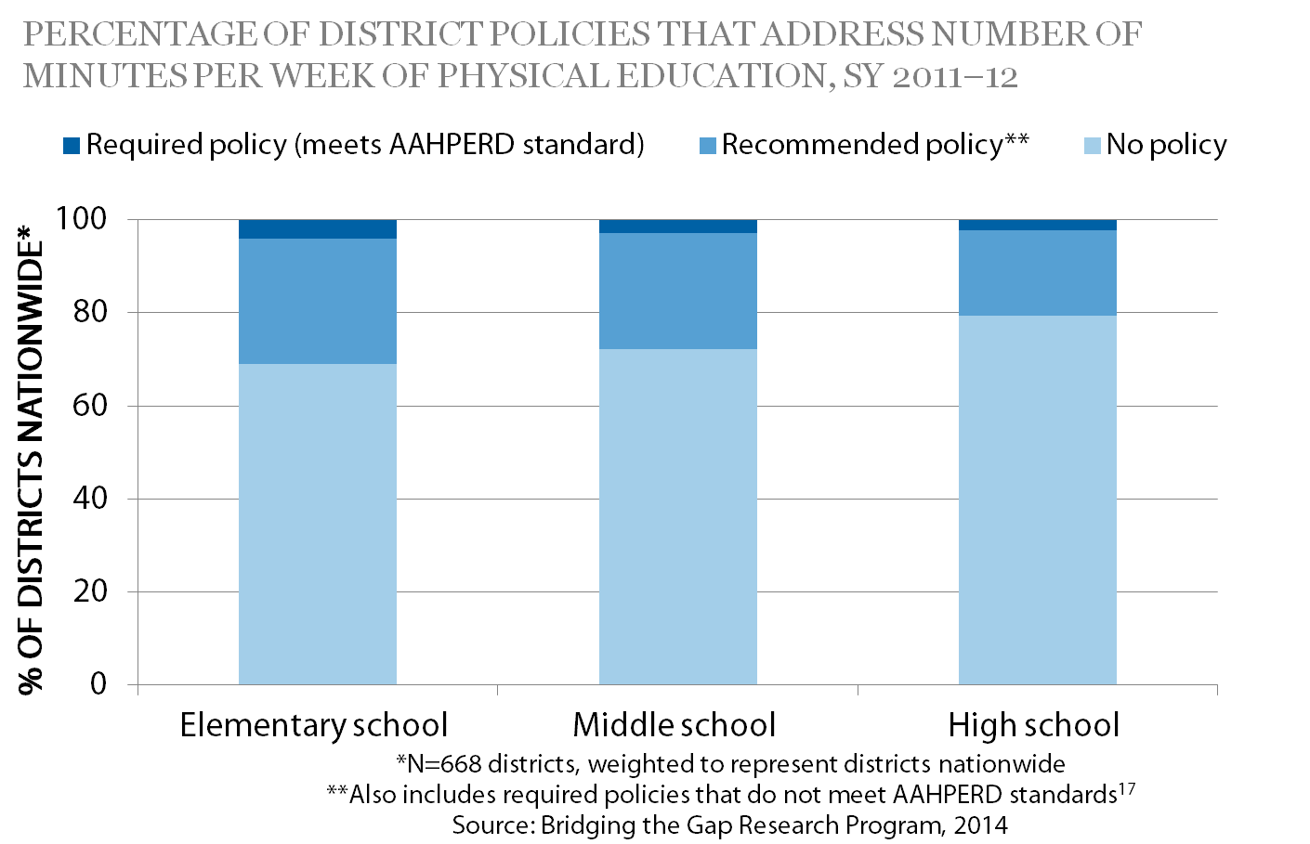
What Actions have School Districts Taken? PE Requirements
Notes:
Narrative:
AAHPERD recommends that elementary students receive 150 minutes and secondary students receive 225 minutes of PE each week. During the 2011–2012 school year, the BTG study found that:
More than 70% of district policies did not address time requirements for PE across grade levels, and very few district policies (less than 5%) met the AAHPERD-recommended time
At the elementary school level, 27% of district recommended that schools meet the AAHPERD-recommended time for PE per week, but only 4% of districts required schools to meet this guideline. When addressed, district PE time provisions ranged 30 –150 minutes per week.
At the middle school level, 25% of district recommended that schools meet the AAHPERD-recommended time for PE per week, but only 2% of districts required schools to meet this guideline. When addressed, district PE time provisions ranged 30 –250 minutes per week.
At the high school level, 18% of district recommended that schools meet the AAHPERD-recommended time for PE per week, but only 2% of districts required schools to meet this guideline. When addressed, district PE time provisions ranged 30 –225 minutes per week.

Slide 18
What Actions Have School Districts Taken? PE Graduation Requirements, SY 2011–12
Only 19% of districts required specific PE graduation requirements.
Nearly 80% of district policies did not include specific PE graduation requirements.
Source: Bridging the Gap Research Program, 2014
Notes:
Narrative:
One way to increase PE among high school students is to require a specific number of PE courses, credits, or hours for graduation. During the 2011–2012 school year,
Only 19% of districts required specific PE graduation requirements.
Nearly 80% of district policies did not include specific PE graduation requirements.

Slide 19
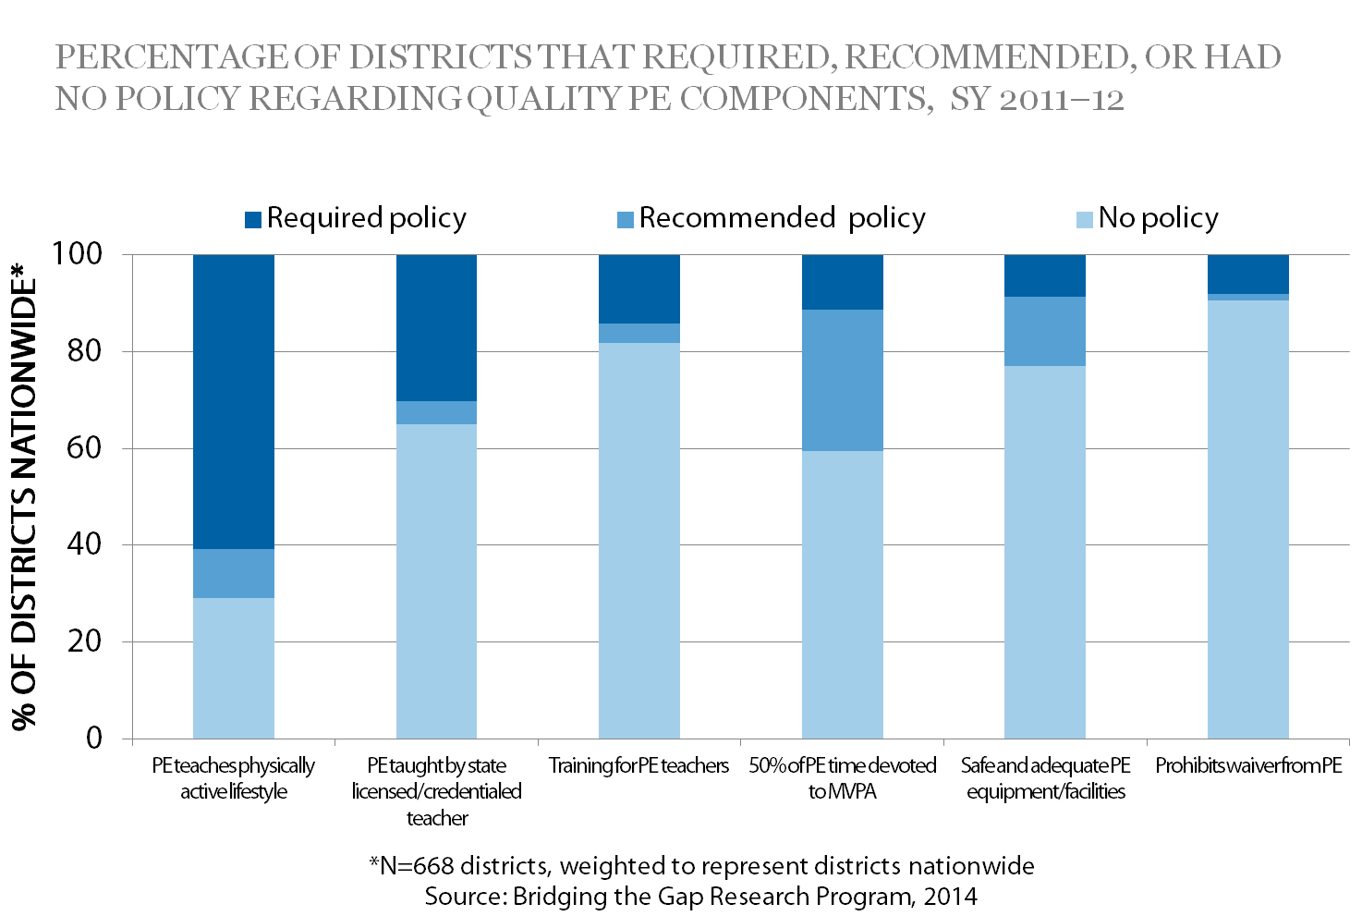
What Actions Have School Districts Taken? Quality PE Components
Notes:
Narrative:
A quality PE program can provide students with the knowledge, skills, and confidence to be physically active throughout their lives. During the 2011–2012 school year,
Nearly 61% of district policies required PE classes to promote a physically active lifestyle or focus on personal fitness.
Only 30% of districts required licensed or credentialed PE teachers.
Only 14% of districts required ongoing training for PE teachers.
Only 11% of districts required students to spend at least 50% of PE time in moderate-to-vigorous physical activity.
Less than 10% of districts had policies that required safe and adequate equipment and facilities.
Only 8% of districts prohibited PE waivers for participation in interscholastic and intramural sports.

Slide 20
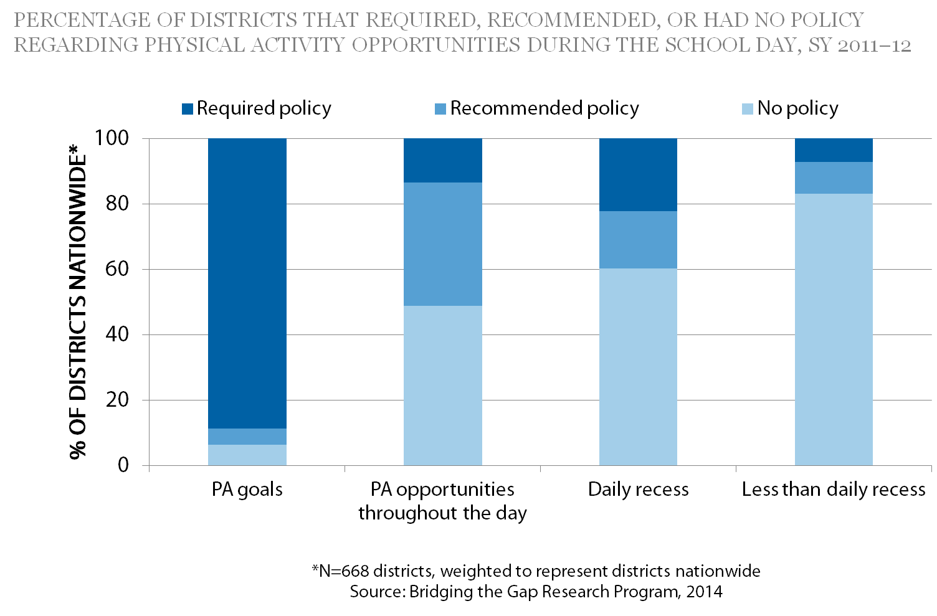
What Actions Have School Districts Taken? PA Opportunities During the School Day
Notes:
Narrative:
To help students meet the national recommendation of 60 minutes daily, schools can provide opportunities for PA during the school day to avoid prolonged periods of inactivity. During the 2011–2012 school year,
89% of districts met the minimum federal wellness policy mandate by specifically including goals for PA in their wellness policies.
14% of districts required, and 38% recommended that PA be integrated throughout the school day (such as through PA breaks in the classroom).
Only 22% of districts required and 18% of districts recommended daily recess for elementary school students. An additional 7% of districts required and 10% of districts recommended recess less than daily for elementary school students.

Slide 21
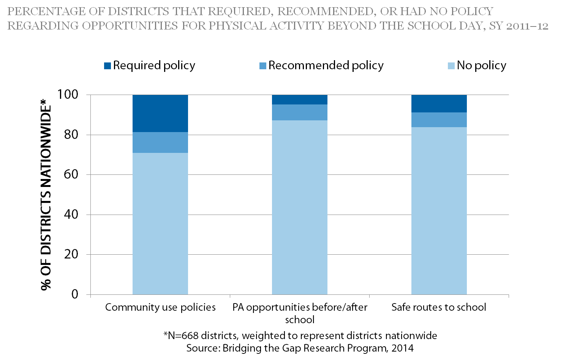
What Actions Have School Districts Taken? PA Opportunities Beyond the School Day
Notes:
Narrative:
School districts can provide PA opportunities beyond the school day (i.e., before or after school, evenings) by using community use and joint use policies and safe routes to school. During the 2011–2012 school year,
Nearly 30% of district wellness policies required or recommended community use of school facilities outside of school hours for PA.
Only 13% of district policies required or recommended that PA opportunities be provided before or after school through agreements with community agencies (e.g., Parks and Recreation, YMCA, and Boys and Girls Clubs).
Only 16% of district wellness policies required or recommended walking or biking to school using safe routes and safe practices.

Slide 22
Supporting the PE and PA Environment
States can^{3,6-12}
Provide districts with professional development and technical assistance for revising district wellness and PE and PA policies
Assist districts with monitoring and reporting on the implementation of district wellness policies
Partner with key organizations such as the state SHAPE America affiliate and state AFHK team to support the implementation of PE and PA policies and practices
Provide professional development opportunities for district PE staff
Notes:
Narrative:
There are a number of evidence-based strategies and expert recommendations that can help improve PE and PA in schools.^{3,6-13} These actions can help you implement these strategies and recommendations.
States can:
Provide districts with professional development and technical assistance for revising district wellness and PE and PA policies.
Assist districts with monitoring and reporting on the implementation of district wellness policies.
Partner with key organizations such as the state AAHPERD affiliate and state Action for Healthy Kids team to support the implementation of PE and PA policies and practices.
Provide professional development opportunities for district PE staff.

Slide 23
Supporting the PE and PA Environment
School districts and schools can^{3,6-12}
Create a school health council or wellness committee that includes district and community stakeholders to implement activities that align with wellness policy goals
Require quality PE for all students that aligns with national and state recommendations and standards
Prohibit waivers allowing students to be exempted from taking PE for participation in interscholastic and intramural sports
Require that state licensed or credentialed teachers instruct all PE classes
Provide ongoing professional development for PE teachers, as well as for other teachers, to incorporate PA as part of non-PE classroom exercises
Offer daily recess for elementary school students
Increase opportunities for children, their families, and the community to be physically active by opening up school facilities outside of school hours
Notes:
Narrative
School districts and schools can:
Create a school health council or wellness committee that includes district and community stakeholders to implement activities that align with wellness policy goals.
Require quality PE for all students that aligns with national and state recommendations and standards.
Prohibit waivers that allow students to be exempted from taking physical education for participation in interscholastic and intramural sports.
Require that state licensed or credentialed teachers instruct all PE classes.
Provide ongoing professional development for PE teachers, as well as for other teachers, to incorporate PA as part of non-PE classroom exercises
Offer daily recess for elementary school students.
Increase opportunities for children, their families, and the community to be physically active by opening up school facilities, such as gymnasiums, playgrounds, and tracks outside of school hours.

Slide 24
Resources for slide set accompanying the brief Strategies For Supporting Quality Physical Education and Physical Activity in Schools
Centers for Disease Control and Prevention. Comprehensive School Physical Activity Programs: A Guide for Schools. http://www.cdc.gov/healthyyouth/physicalactivity/cspap.htm.
Centers for Disease Control and Prevention. Adolescent and School Health. Physical Education Curriculum Analysis Tool (PECAT). http://www.cdc.gov/healthyyouth/pecat/index.htm.
American Alliance for Health, Physical Education, Recreation and Dance. National Physical Education Standards. http://www.shapeamerica.org/standards/pe/.
American Alliance for Health, Physical Education, Recreation and Dance. Comprehensive School Physical Activity Programs: Helping All Students Achieve 60 Minutes of Physical Activity Each Day. http://www.shapeamerica.org/advocacy/positionstatements/pa/loader.cfm?csModule=security/getfile&pageid=4726.
Notes:
Narrative:
This slide lists key resources that provide additional information on the topics covered in this presentation.

Slide 25
Cont’d: Resources for slide set accompanying the brief Strategies For Supporting Quality Physical Education and Physical Activity in Schools
American Alliance for Health, Physical Education, Recreation and Dance. Position Statement: Recess for Elementary School Students. http://www.shapeamerica.org/advocacy/positionstatements/pa/loader.cfm?csModule=security/getfile&pageid=4630.
US Department of Health and Human Services. Physical Activity Guidelines for Americans Midcourse Report: Strategies to Increase Physical Activity among Youth. http://www.health.gov/paguidelines/midcourse/pag-mid-course-report-final.pdf.
Safe Routes. National Center for Safe Routes to School. http://www.saferoutesinfo.org.
Bridging the Gap Research. School district wellness policy-related reports and materials. http://www.bridgingthegapresearch.org/research/district_wellness_policies.
Notes:
Narrative:
This slide lists key resources that provide additional information on the topics covered in this presentation.

Slide 26
References for slide set accompanying the brief Strategies For Supporting Quality Physical Education and Physical Activity in Schools
U.S. Department of Health and Human Services. Physical Activity Guidelines Advisory Committee Report. Washington, DC: U.S. Department of Health and Human Services; 2008.
Physical Activity Guidelines for Americans Midcourse Report Subcommittee of the President’s Council on Fitness, Sports & Nutrition. Physical Activity Guidelines for Americans Midcourse Report: Strategies to Increase Physical Activity among Youth. Washington, DC: U.S. Department of Health and Human Services; 2012.
Child Nutrition and WIC Reauthorization Act, Pub. L. No. 108-265, § 204, 118 Stat. 729, 780-781 (2004).
Healthy, Hunger-Free Kids Act of 2010, Pub. L. No. 111-296, § 204, 124 Stat. 3183, 3236-3238 (2010).
Centers for Disease Control and Prevention. School health guidelines to promote healthy eating and physical activity. MMWR 2011;60:1–76.
American Academy of Pediatrics. Policy Statement: The Crucial Role of Recess in School. Pediatrics 2013;131:183-188.
Centers for Disease Control and Prevention. Recommended Community Strategies and Measurements to Prevent Childhood Obesity in the United States. MMWR 2009; 58.

Slide 27
References for slide set accompanying the brief Strategies For Supporting Quality Physical Education and Physical Activity in Schools
American Academy of Pediatrics. Prevention and Treatment Childhood Overweight and Obesity: Policy Tool. Available at: http://www2.aap.org/obesity/schools_1.html.
Institute of Medicine. Accelerating Progress in Obesity Prevention: Solving the Weight of the Nation. Washington, DC: The National Academies Press; 2012.
Institute of Medicine. Local Government Actions to Prevent Childhood Obesity. Washington, DC: The National Academies Press; 2009.
Institute of Medicine. Physical Activity and Physical Education in the School Environment. Washington, DC: The National Academies Press; 2013.
Institute of Medicine. Educating the Student Body: Taking Physical Activity and Physical Education to School. Washington D.C.: The National Academies Press, 2013.

Slide 28
Strategies to Support Recess in Elementary Schools
July, 2014
Suggested fact sheet citation: Centers for Disease Control and Prevention and Bridging the Gap Research Program. Strategies for Supporting Recess in Elementary Schools. Atlanta, GA: U.S. Department of Health and Human Services; 2014.
Notes:
Narrative:
The next several slides will highlight key findings and recommendations from the research brief Strategies to Support Recess in Elementary Schools.

Slide 29
Brief Purpose
Highlights areas where school recess policy opportunities exist, and where policies are well-established
Summarizes actions taken by school districts and states relative to recess
Notes:
Narrative:
This brief highlights areas where school recess policy opportunities exist, and where policies are well-established.
It summarizes policy actions taken by public school districts, all 50 states and the District of Columbia from the 2011–2012 school year, from the Bridging the Gap (BTG) study.

Slide 30
Impact on Health
Recess
Provides students with a break from their structured school day
Can improve children’s physical, social, and emotional well-being^{1,2}
Can enhance learning³
Helps children meet the goal of 60 minutes of PA per day⁴
Notes:
Narrative:
Recess provides students with a needed break from their structured school day. It can improve children’s physical, social, and emotional well-being,^{1,2} and enhance learning.³ Recess helps children meet the goal of 60 minutes of physical activity (PA) each day, as recommended by the US Department of Health and Human Services.⁴

Slide 31
What do the Experts Recommend?
National organizations recommend that districts provide at least 20 minutes of daily recess for all students in elementary schools.^{2,5-9}
Notes:
Narrative:
National organizations (e.g., Centers for Disease Control and Prevention, American Academy of Pediatrics, SHAPE America) recommend that districts provide at least 20 minutes of daily recess for all students in elementary schools.

Slide 32
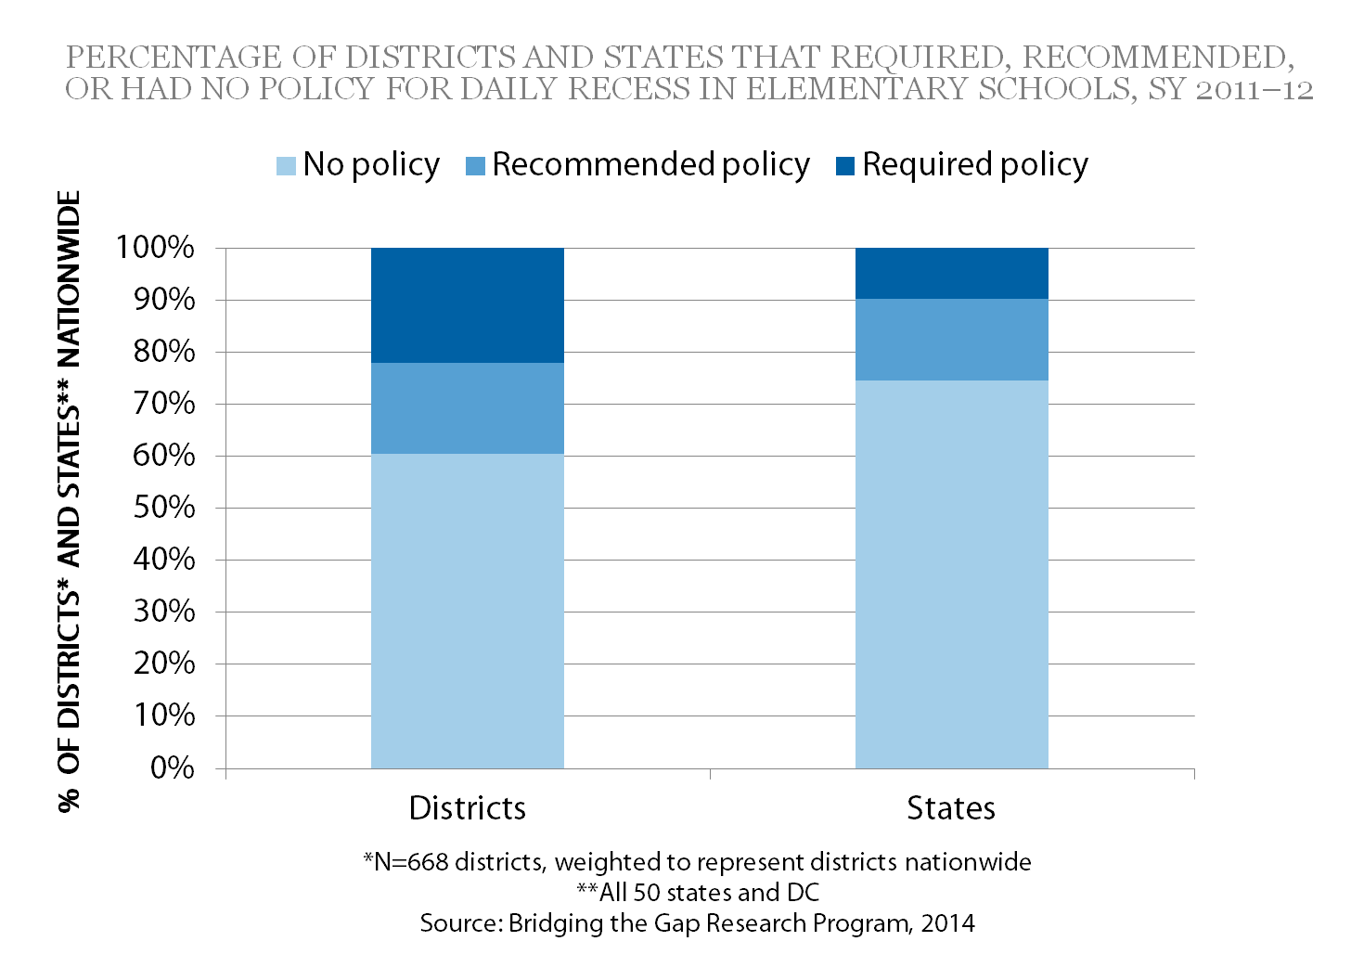
What Actions Have School Districts Taken? Recess Policies in Elementary Schools
Notes:
Narrative:
This brief highlights areas where school recess policy opportunities exist, and where policies are well-established. It summarizes policy actions taken by public school districts, all 50 states and the District of Columbia from the 2011–2012 school year, from the Bridging the Gap (BTG) study.
Few school district wellness and state policies address daily recess for elementary school or address recess as part of policy provisions for daily physical activity. During the 2011–2012 school year, the BTG study found that:
At the District Level:
60% of districts had no policy regarding daily recess for elementary school students.
22% of districts required and18% recommended daily recess for elementary school students. Fewer than one half and one third of these, respectively, required at least 20 minutes of daily recess.
Less than 7% of districts required and 3% recommended a set amount of time for PA during the school day; two-thirds and fewer than half of which included recess in the definition of PA.
At the State Level:
Only 5 states required and 8 recommended daily recess for elementary school students. Among these, only one state required and 2 recommended at least 20 minutes of daily recess.
10 states required a set amount of time for PA during the school day; half of these included recess in the definition of PA.
4 states recommended a specific amount of time for PA throughout the school day; only 1 of these states included recess in the definition of PA.

Slide 33
Encouraging Daily Recess
STATES can^{2,4-9}
Develop and adopt daily recess policies, and monitor district and school implementation
Work with districts to upgrade and maintain PA equipment and facilities that are used for recess
Provide districts with training and technical assistance for aligning wellness and recess policies with national recommendations
Assist districts with monitoring and reporting on the implementation of district wellness policies
Notes:
Narrative:
There are a number of evidence-based strategies and expert recommendations to improve recess in schools. The actions below can help you implement these strategies and recommendations. See the Resources slide at the end of this section for links to documents and websites that provide additional information.
States Can:^{2,4-9}
Develop and adopt daily recess policies, and monitor district and school implementation.
Work with districts to upgrade and maintain PA equipment, sports fields, courts, and playgrounds that are used for recess.
Provide districts with training and technical assistance for revising district wellness and recess policies that align with national recommendations.
Assist districts with monitoring and reporting on the implementation of district wellness policies.

Slide 34
Encouraging Daily Recess
School districts and schools can^{2,4-9}
Create a school health council that includes district and community stakeholders to implement, monitor, and evaluate activities that align with wellness policy goals
Review and revise the district wellness policy to align with national recess recommendations
Assist schools with implementing the policy
Make the district wellness policy available to parents and other stakeholders (e.g., district website)
Involve stakeholders in reviewing and revising district wellness and recess policies
Offer daily recess for elementary school students in addition to PE
Maintain safe and age-appropriate equipment for students to use during recess
Ensure that well-trained supervisors are present during recess
Notes:
Narrative:
School districts and schools can:^{2,4-9}
Create a school health council that includes district and community stakeholders to implement, monitor, and evaluate activities that align with wellness policy goals.
Review and revise the district wellness policy to align with national recess recommendations and assist schools with implementing the policy.
Make the district wellness policy available to parents and other stakeholders (e.g., district website).
Involve parents and other stakeholders in reviewing and revising district wellness and recess policies.
Offer daily recess for elementary school students in addition to PE.
Maintain safe and age-appropriate equipment for students to use during recess.
Ensure that well-trained supervisors are present during recess.

Slide 35
Resources for slide set accompanying the brief Strategies for Supporting Recess in Elementary Schools
U.S. Department of Health and Human Services. Physical Activity Guidelines for Americans Midcourse Report: Strategies to Increase Physical Activity among Youth. http://www.health.gov/paguidelines/midcourse/pag-mid-course-report-final.pdf.
USDA Food and Nutrition Service. Local School Wellness Policy. http://www.fns.usda.gov/tn/local-school-wellness-policy.
USDA Healthy Meals Resource System. School Nutrition Environment and Wellness Resources. http://healthymeals.nal.usda.gov/school-wellness-resources.
Bridging the Gap Research. School district wellness policy-related reports and materials. http://www.bridgingthegapresearch.org/research/district_wellness_policies.
Notes:
Narrative:
This slide lists key resources that provide additional information on the topics covered in this presentation.

Slide 36
Cont’d: Resources for slide set accompanying the brief Strategies for Supporting Recess in Elementary Schools
American Alliance for Health, Physical Education, Recreation and Dance. Position Statement: Recess for Elementary School Students. http://www.shapeamerica.org/advocacy/positionstatements/pa/loader.cfm?csModule=security/getfile&pageid=4630.
International Play Association. Promoting Recess. http://www.ipausa.org/recess_pages/promoting_recess.html .
American Academy of Pediatrics. Policy Statement: The Crucial Role of Recess in School. http://pediatrics.aappublications.org/content/131/1/183.full.pdf.
Notes:
Narrative:
This slide lists key resources that provide additional information on the topics covered in this presentation.

Slide 37
References for slide set accompanying the brief Strategies for Supporting Recess in Elementary Schools
Ramstetter CL, Murray R, Garner AS. The crucial role of recess in schools. Journal of School Health 2010;80:517-526.
American Academy of Pediatrics. Policy Statement: The Crucial Role of Recess in School. Pediatrics 2013;131:183-188.
Centers for Disease Control and Prevention. The Association between school-based physical activity, including physical education, and academic performance. Atlanta, GA: U.S. Department of Health and Human Services; 2010.
U.S. Department of Health and Human Services. 2008 Physical Activity Guidelines for Americans.
Centers for Disease Control and Prevention. School health guidelines to promote healthy eating and physical activity. MMWR 2011;60:1–76.
American Academy of Pediatrics. Prevention and Treatment Childhood Overweight and Obesity: Policy Tool. Available at: http://www2.aap.org/obesity/schools_1.html.
Institute of Medicine. Accelerating Progress in Obesity Prevention: Solving the Weight of the Nation. Washington, DC: The National Academies Press; 2012.
Institute of Medicine. Educating the Student Body: Taking Physical Activity and Physical Education to School. Washington, DC: The National Academies Press; 2013.
American Alliance for Health, Physical Education, Recreation and Dance. Position Statement: Recess for Elementary School Students. http://www.shapeamerica.org/advocacy/positionstatements/pa/loader.cfm?csModule=security/getfile&pageid=4630.

Slide 38
Strategies for Creating Supportive School Nutrition Environments
July, 2014
Suggested brief citation: Centers for Disease Control and Prevention and Bridging the Gap Research Program. Strategies for Creating Supportive School Nutrition Environments. Atlanta, GA: U.S. Department of Health and Human Services; 2014.
Notes:
Narrative:
The next several slides will highlight key findings and recommendations from the research brief Policy Strategies for Creating Supporting School Nutrition Environments.

Slide 39
Brief Purpose
Highlights areas where policy opportunities exist, as well as areas where policies are well-established relative to
Nutrition standards for competitive foods and beverages
Marketing and promotion of foods and beverages
Access to free drinking water
Nutrition education
Farm to School programs and school gardens
Nutrition-related training for school personnel
Strategies to increase participation in school meals
Notes:
Narrative:
This brief highlights areas where policy opportunities exist, as well as areas where policies are well-established relative to the following topics: 1) nutrition standards for competitive foods and beverages (i.e., items sold or served outside the school meal programs); 2) marketing and promotion of foods and beverages at school; 3) access to free drinking water; 4) nutrition education for students; 5) Farm to School programs and school gardens; 6) nutrition-related training for school personnel; and 7) strategies to increase participation in school meals. This brief summarizes the range of policy actions taken by public school districts from a nationally representative sample of district wellness policies from the 2011–2012 school year, from the Bridging the Gap (BTG) study.

Slide 40
Impact on Health
Good nutrition is vital for optimal health.^{1,2}
Schools have the potential to shape healthy behaviors, including eating habits.
A supportive nutrition environment provides
Access to healthy foods in all venues
Consistent messages about healthy eating
Opportunities for students to learn about healthy eating
Improving nutrition can improve physical health and academic achievement. ³⁻⁵
Notes:
Narrative:
Good nutrition is vital to optimal health. The school environment plays a fundamental role in shaping lifelong healthy behaviors and can have a powerful influence on students’ eating habits. A supportive school nutrition environment includes multiple elements: access to healthy and appealing foods and beverages available to students in school meals, vending machines, school stores, à la carte lines in the cafeteria, fundraisers, and classroom parties; consistent messages about food and healthy eating; and the opportunities students have to learn about healthy eating. Improving the school nutrition environment has the potential to improve students’ physical health and academic achievement.

Slide 41
What Do the Experts Recommend?
National organizations recommend that schools^{3,4,6-8}
Provide healthy and appealing foods
Limit marketing of low-nutrient, high calorie foods
Implement Farm to School programs
Provide nutrition education
Notes:
Narrative:
National organizations, such as the Centers for Disease Control and Prevention, Institute of Medicine, and American Academy of Pediatrics, have made recommendations for schools to implement policies and practices that support healthy eating. These recommendations include ensuring that all foods available during the school day are healthy and appealing, limiting students’ exposure to marketing for low-nutrient, high calorie foods, implementing Farm to School programs, and providing nutrition education.

Slide 42
What Actions Have School Districts Taken?
Nutrition standards for competitive food and beverages
Marketing and promotion of foods and beverages
Access to free drinking water on school campuses
Nutrition education for students
Farm to School programs and school gardens
Nutrition-related training for school personnel
Policy strategies to increase participation in school meals
Notes:
Narrative:
The next several slides will examine where policy opportunities exist and areas where policies are well-established relative to the following topics:
Nutrition standards for competitive food and beverages (i.e. those items sold and served outside of the school meals programs)
Marketing and promotion of foods and beverages
Access to free drinking water on school campuses
Nutrition education for students
Farm to School programs and school gardens
Nutrition-related training for school personnel
Policy strategies to increase participation in school meals

Slide 43
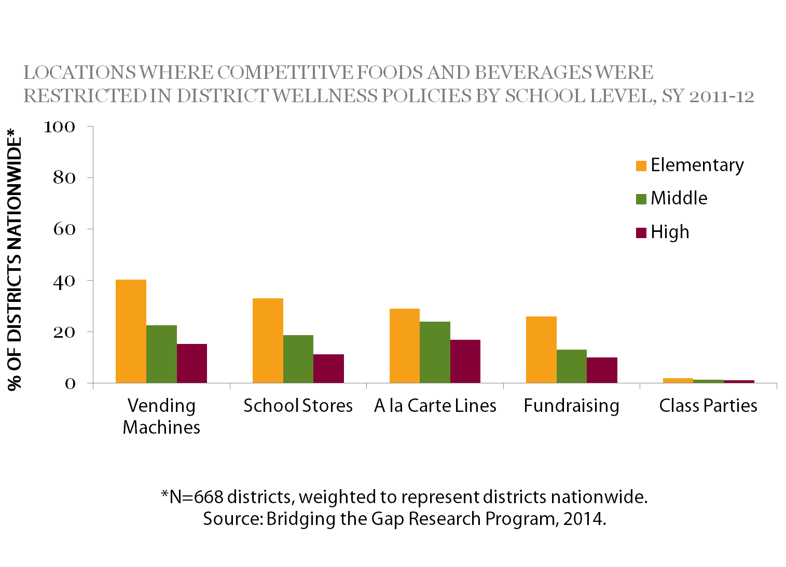
What Actions Have School Districts Taken? Nutrition Standards for Competitive Foods and Beverages
Notes:
Narrative:
Competitive food and beverage policy provisions varied by location of sale within the school, specific nutrient restrictions, and grade level. During the 2011–2012 school year, the BTG study found that:
The most common restrictions regarding competitive foods were for vending machines, followed by school stores and à la carte lines in the cafeteria. Few districts had policy restrictions regarding class parties.

Slide 44
What Actions Have School Districts Taken? Nutrition Standards for Competitive Foods and Beverages
Notes:
Narrative:
The data also showed that the highest percentage of policies included requirements for limiting fats in foods, and the smallest percentage of policies included requirements for limits on sodium. Fat content was restricted by the wellness policy in more locations, whereas sodium was restricted in fewer locations. This was consistent for all school levels.

Slide 45
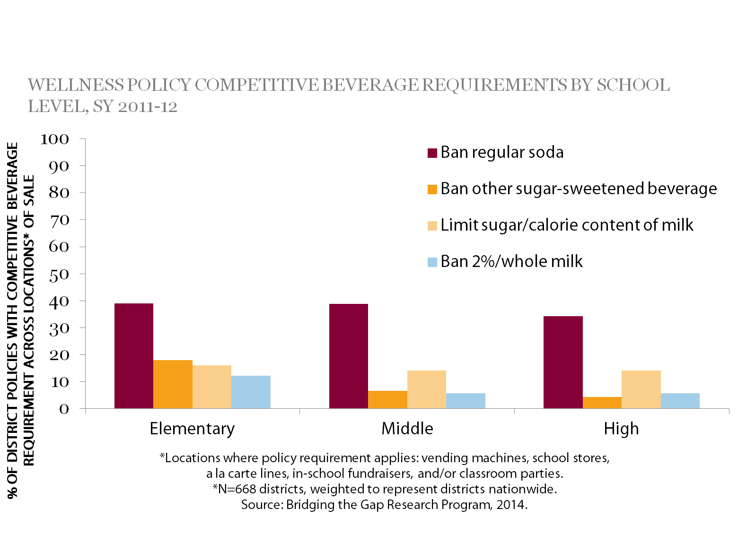
What Actions Have School Districts Taken? Nutrition Standards for Competitive Foods and Beverages
Notes:
Narrative:
Policy prohibitions on soda sales were addressed in more locations; fewer locations had policy provisions that prohibited the sale of other sugar-sweetened beverages or high-fat milks.

Slide 46
What Actions Have School Districts Taken? Marketing and Promotion of Foods and Beverages, SY 2011–12
14% of districts prohibited all forms of advertising and promotion of unhealthful choices.
5% of districts promoted marketing of healthful items or used strategies to encourage healthy choices.
Source: Bridging the Gap Research Program, 2014
Notes:
Narrative:
The ways in which foods and beverages are marketed and promoted can affect students’ eating behaviors. During the 2011–2012 school year,
14% of districts prohibited all forms of advertising and promotion of unhealthful choices (e.g., prohibiting soft drink logos on school material or property).
5% of districts promoted marketing of healthful items or used strategies to encourage healthy choices (e.g., priced nutritious foods and beverages at a lower cost and increased the price of less nutritious foods and beverages).

Slide 47
What Actions Have School Districts Taken? Access to Free Drinking Water on School Campuses, SY 2011–12
10% of districts required free access to drinking water throughout the school day.
9% of districts required free access to drinking water during school meals.
Source: Bridging the Gap Research Program, 2014
Notes:
Narrative:
Providing and promoting drinking water throughout the day gives students an alternative to sugar-sweetened beverages. During the 2011–2012 school year,
Only 10% of districts required free access to drinking water throughout the school day.
Just 9% of districts required free access to drinking water during school meals.
USDA requires that schools participting in the National School Lunch Program (NSLP) make plain (i.e., no flavoring, additives, or carbonation), drinking water available to students at no cost during the lunch meal periods in the location where meals are served. Schools must also make drinking water available during the School Breakfast Program (SBP) when breakfast is served in the cafeteria.
However, this data indicate that few districts are incorporating langauge about water into their wellness policy.

Slide 48
What Actions Have School Districts Taken? Nutrition Education for Students, SY 2011–12
52% of districts required skill-based nutrition education.
35% of districts required a nutrition education curriculum be provided for each grade level.
Less than 1% of district policies required a specific number of nutrition education courses or contact hours.
Source: Bridging the Gap Research Program, 2014
Notes:
Narrative:
Schools can provide nutrition education and engage in nutrition promotion as part of the k-12 health education curriculum. During the 2011–2012 school year,
Slightly more than one-half (52%) of districts required skill-based nutrition education.
Only 35% of districts required a nutrition education curriculum be provided for each grade level.
Less than 1% of district policies required a specific number of nutrition education courses or contact hours.

Slide 49
What Actions Have School Districts Taken? Farm to School Programs and School Gardens, SY 2011–12
Approximately 1% of district policies required Farm to School programs or locally-grown food to be purchased for school meals.
1% of districts required a school garden.
Source: Bridging the Gap Research Program, 2014
Notes:
Narrative:
Farm to School programs and school gardens connect schools and local farms with the objective of serving locally produced foods in school cafeterias and providing nutrition education opportunities such as cooking demonstrations, taste tests, and farm tours. During the 2011–2012 school year,
Slightly more than 1% of district policies required Farm to School programs or locally-grown food to be purchased for school meals.
Only 1% of districts required a school garden.

Slide 50
What Actions Have School Districts Taken? Nutrition-Related Training for School Personnel, SY 2011–12
12% of districts required nutrition education training or professional development for all district staff.
10% of districts required nutrition education training or professional development for food service staff.
Source: Bridging the Gap Research Program, 2014
Notes:
Narrative:
Properly trained staff at all levels are essential for creating a supportive school nutrition environment. Professional development may include teaching district staff how to implement an age-appropriate nutrition education curriculum, integrate nutrition topics into the overall curriculum, as well as training food service staff to prepare or serve healthy and appealing school meals. During the 2011–2012 school year,
12% of districts required nutrition education training or professional development for all district staff.
10% of districts required nutrition education training or professional development for food service staff.

Slide 51
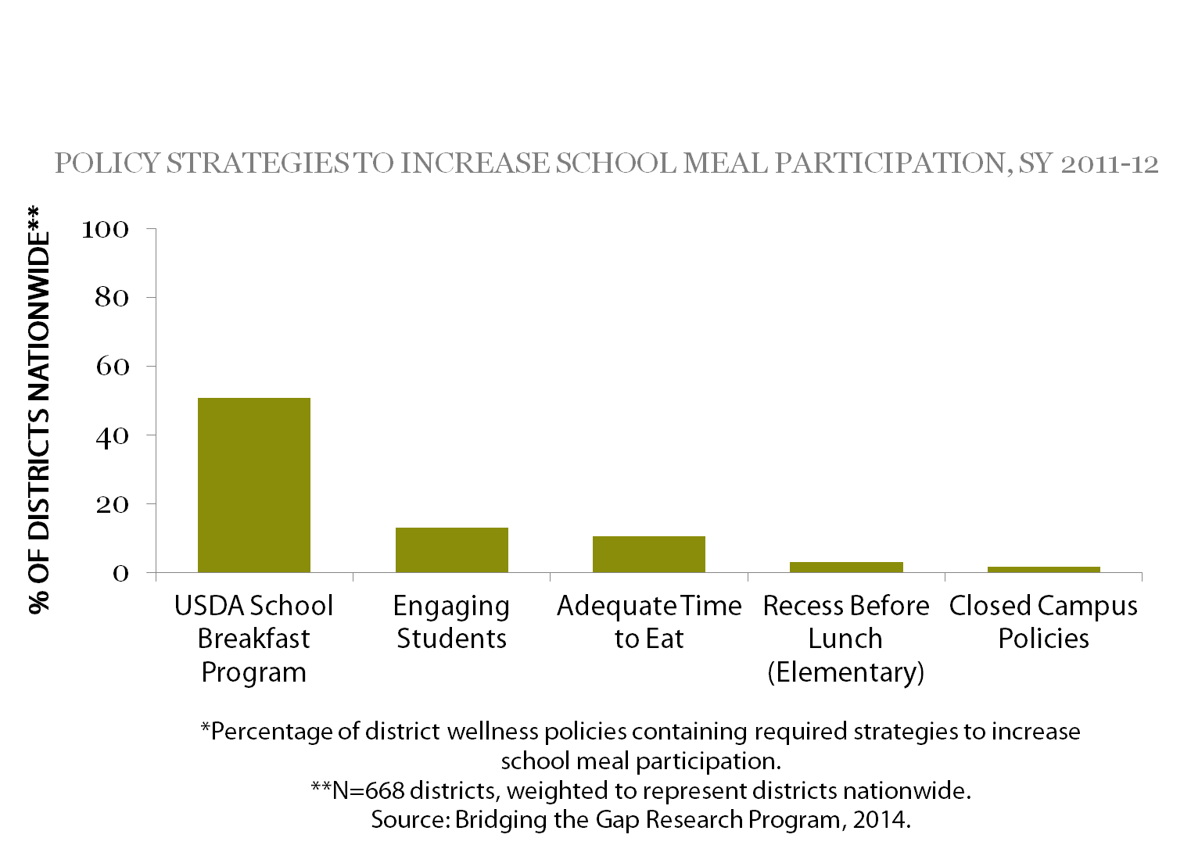
What Actions Have School Districts Taken? School Meals Participation
Notes:
Narrative:
Districts can implement a variety of strategies including scheduling recess before lunch at the elementary school level, instituting closed campus policies at the secondary level (i.e., students cannot leave campus for lunch), providing adequate time to eat meals (i.e., 10 minutes per day for breakfast and 20 minutes per day for lunch), and offering grab-and-go breakfast. In addition, districts can engage students and other stakeholders in the decision making process through taste-testing of new foods and satisfaction surveys to improve school meal participation. The figure illustrates the strategies required during the 2011–2012 school year.

Slide 52
Supporting School Nutrition
States can^{6,7,9-13}
Provide training and technical assistance to districts on revising district wellness policies to align with national recommendations
Assist districts with monitoring and reporting on the implementation of district wellness policies
Educate districts and relevant state groups on elements of a healthy school nutrition environment
Work to develop Farm to School programs
Work with districts to update school kitchens with the equipment needed to prepare healthy meals
Provide nutrition training and professional development opportunities for district and food service staff
Support standards-based nutrition education for districts and schools
Notes:
Narrative:
There are a variety of evidence based strategies and expert recommendations that can be implemented that states, districts, and schools can implmenet to support a healthy school nutrition environment.
States can:
Provide training and technical assistance to districts on revising district wellness policies to align with national recommendations.
Assist districts with monitoring and reporting on the implementation of district wellness policies.
Educate districts and relevant state groups on elements of a healthy school nutrition environment including nutrition standards that meet or exceed the United States Department of Agriculture’s (USDA) “Smart Snacks in School” nutrition standards for all foods sold in school.
Work to develop Farm to School programs.
Work with districts to update school kitchens with the equipment needed to prepare healthy meals (e.g., slicers, sectioners, and reach-in coolers to prepare and store fruits and vegetables).
Provide nutrition training and professional development opportunities for district and food service staff.
Support standards-based nutrition education for districts and schools.

Slide 53
Supporting School Nutrition
School districts and Schools can^{6,7,9-13}
Review and revise the district wellness policy to align with national recommendations
Assist schools with implementing the policy
Implement strong nutrition standards that meet or exceed the USDA’s “Smart Snacks in School” nutrition standards for all foods sold in school
Prohibit marketing of unhealthful items, and promote more healthful items
Encourage school staff to model healthy eating behaviors
Adopt strategies to improve school meal participation rates
Notes:
Narrative:
School districts and schools can:
Create a school health council that includes district and community stakeholders to assess, implement, monitor, and evaluate the district wellness policy.
Review and revise the district wellness policy to align with national recommendations, and assist schools with implementing the policy.
Implement strong nutrition standards that meet or exceed the USDA’s “Smart Snacks in School” nutrition standards for all foods sold in school.
Make the district wellness policy and nutrition standards publicly available to parents and other stakeholders (e.g., district Web site), and involve them in reviewing and revising these policies.
Prohibit marketing of unhealthful items, and promote more healthful items.
Encourage school staff to model healthy eating behaviors.
Link nutrition education activities with State Health Education Frameworks or Standards.
Provide nutrition training and professional development opportunities for all school staff.
Provide parents with nutrition education materials.
Adopt strategies to improve school meal participation rates, including ensuring adequate time for students to eat meals, incorporating alternative breakfast options, and conducting taste tests.
Ensure that all students have access to free drinking water during the school day.

Slide 54
Resources for slide set accompanying the brief Strategies for Creating Supportive School Nutrition Environments
CDC. Healthy Youth! Nutrition, Physical Activity and Obesity. www.cdc.gov/healthyyouth/npao.
USDA. School Nutrition Environment and Wellness Resources. healthymeals.nal.usda.gov/school-wellness-resources.
USDA. Local School Wellness Policies. www.fns.usda.gov/tn/local-school-wellness-policy.
USDA. Smart Snacks in School. http://www.fns.usda.gov/school-meals/smart-snacks-schools.
Bridging the Gap Research. School district wellness policy-related reports and materials. www.bridgingthegapresearch.org/research/district_wellness_policies.
Notes:
Narrative:
This slide lists key resources that provide additional information on the topics covered in this presentation.
Centers for Disease Control and Prevention. Healthy Youth! Nutrition, Physical Activity and Obesity. http://www.cdc.gov/healthyyouth/npao/.
USDA Healthy Meals Resource System. School Nutrition Environment and Wellness Resources. http://healthymeals.nal.usda.gov/school-wellness-resources.
USDA Food and Nutrition Service. Local School Wellness Policies. http://www.fns.usda.gov/tn/local-school-wellness-policy.
USDA Food and Nutrition Service. Smart Snacks in School. http://www.fns.usda.gov/school-meals/smart-snacks-schools.
USDA Team Nutrition. http://www.teamnutrition.usda.gov/.
USDA Farm to School. http://www.fns.usda.gov/farmtoschool.
National Food Service Management Institute. http://www.nfsmi.org/.
Let's Move. Schools Take Action: 5 Simple Steps to Success. http://www.letsmove.gov/sites/letsmove.gov/files/pdfs/TAKE_ACTION_SCHOOLS.pdf.
Bridging the Gap Research. School district wellness policy-related reports and materials.
http://www.bridgingthegapresearch.org/research/district_wellness_policies.

Slide 55
References for slide set accompanying the brief Strategies for Creating Supportive School Nutrition Environments
Centers for Disease Control and Prevention. Basics about Childhood Obesity. 2012. Available at: http://www.cdc.gov/obesity/childhood/basics.html.
U.S. Department of Agriculture and U.S. Department of Health and Human Services. Dietary Guidelines for Americans, 2010. 7th Edition, Washington, DC: U.S. Government Printing Office, December 2010.
Centers for Disease Control and Prevention. School health guidelines to promote healthy eating and physical activity. MMWR 2011;60:1–76.
Institute of Medicine. Accelerating Progress in Obesity Prevention: Solving the Weight of the Nation. Washington, DC: The National Academies Press; 2012.
Kleinman RE, Hall S, Green H, Korzec-Ramirez D, Patton K, Pagano ME, Murphy JM. Diet, breakfast, and academic performance in children. Ann Nutr Metab 2002;46 Suppl 1:24-30.
Institute of Medicine. Food Marketing to Children: Threat or Opportunity? Washington, DC: National Academies Press; 2005.
American Academy of Pediatrics. Prevention and Treatment Childhood Overweight and Obesity: Policy Tool. Available at: http://www2.aap.org/obesity/schools_5.html.

Slide 56
References for slide set accompanying the brief Strategies for Creating Supportive School Nutrition Environments
Institute of Medicine. Nutrition Standards for Foods in Schools: Leading the Way toward Healthier Youth. Washington, DC: The National Academies Press; 2007.
Centers for Disease Control and Prevention. Recommended community strategies and measurements to prevent childhood obesity in the United States. MMWR 2009;58:1–26.
American Academy of Pediatrics. Prevention and Treatment Childhood Overweight and Obesity: Policy Tool. Available at: http://www2.aap.org/obesity/schools_5.html.
Institute of Medicine. Food Marketing to Children: Threat or Opportunity? Washington, DC: National Academies Press; 2005.
Institute of Medicine. Local Government Actions to Prevent Childhood Obesity. Washington, DC: The National Academies Press; 2009.
Institute of Medicine. Nutrition Standards for Foods in Schools: Leading the Way toward Healthier Youth. Washington, DC: The National Academies Press; 2007.

Slide 57
Strategies for Improving Access to Drinking Water in Schools
July, 2014
Suggested fact sheet citation: Centers for Disease Control and Prevention and Bridging the Gap Research Program. Strategies for Improving Access to Drinking Water in Schools. Atlanta, GA: U.S. Department of Health and Human Services; 2014.
Notes:
Narrative:
The next several slides will highlight key findings and recommendations from the research brief Strategies for Improving Access to Drinking Water in Schools.

Slide 58
Brief Purpose
Highlights areas where
Local school wellness policies address water accessibility
Policy opportunities exist
Summarizes actions taken by school districts relative to water accessibility
Notes:
Narrative:
This brief highlights areas where local school wellness policies (i.e., wellness policies) address water accessibility and where policy opportunities exist. It summarizes policy actions taken by public school districts from 2011–2012 school year from the Bridging the Gap (BTG) study.

Slide 59
Impact on Health
Water consumption is important¹⁻³ for students’
Cognition
Dental health
Physical health
Availability and promotion of free water at school
Increases students’ water consumption^{4,5}
May prevent school children from being overweight³
Notes:
Narrative:
Water consumption is important for students’ cognition, dental health, and physical health. The availability and promotion of free water during the school day has been shown to increase water consumption and may prevent school children from being overweight.

Slide 60
What do the experts recommend?
The Institute of Medicine recommends making free, potable water available.⁶
The American Academy of Pediatrics recommend that districts provide students with access to free drinking water throughout the school day.⁷
Federal requirements (USDA)⁸ for water availability in
National School Lunch Program
School Breakfast Program
Notes:
Narrative:
The Institute of Medicine recommends making free, potable water available as a means to decrease sugar-sweetened beverage consumption by children and adolescents.⁶ National organizations, including the American Academy of Pediatrics, recommend that districts provide students with access to free drinking water throughout the school day.⁷ Furthermore, the United States Department of Agriculture (USDA) requires that schools participating in the National School Lunch Program make free, potable water available during meals in places where meals are served. Schools must also make drinking water available during the School Breakfast Program when breakfast is served in the cafeteria.⁸

Slide 61
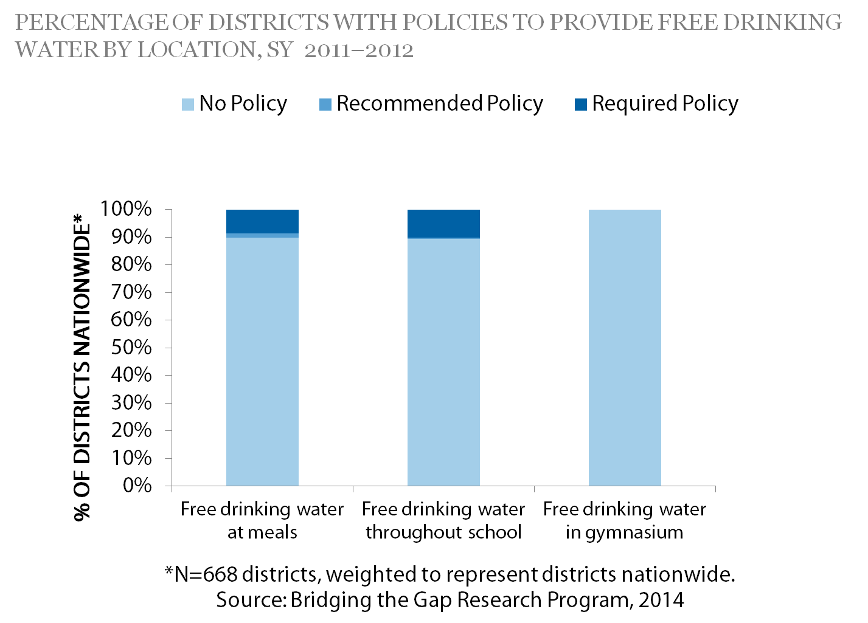
What Actions Have School Districts Taken? Water Policies in Schools
Notes:
Narrative:
Few wellness policies addressed water accessibility in schools (Figure 1). During the 2011–2012 school year, the BTG study found that
Only 9% of districts required that free drinking water be available in places where meals are served, and approximately 2% of districts recommended free drinking water be available where meals are served.
Approximately 90% of school districts do not have a policy for access to free water on the school campus.
10% of districts required that free drinking water be available throughout the school day and throughout the school campus. Less than 1% of districts recommended that free drinking water be available throughout the day on school campuses.
No districts required or recommended that free drinking water be available in the gymnasium.

Slide 62
Improving Water Access
States can^{6,9,10}
Work with districts to ensure that free, clean, and safe drinking water is available throughout school campuses
Help districts secure funding to improve the condition of water fountains
Strengthen building codes that affect the availability of drinking water
Encourage school districts and schools to promote water consumption by using marketing campaigns and practices that make water easily accessible (e.g., allowing students to bring water bottles into classrooms)
Notes:
Narrative:
There are a number of evidence-based strategies and expert recommendations^{6,12,13} that can help improve access to drinking water in schools. The actions below can help you implement these strategies and recommendations. See the Resources section at the end for links to documents and Web sites that provide additional information.
States can:
Work with districts to ensure that free, clean, and safe drinking water is available throughout school campuses.
Help districts secure funding to improve the condition of water fountains.
Strengthen building codes that affect the availability of drinking water.
Encourage school districts and schools to promote water consumption by using marketing campaigns and practices that make water easily accessible (e.g., allowing students to bring water bottles into classrooms).

Slide 63
Improving Water Access
School districts and schools can^{6,9,10}
Include language about drinking water access in the district wellness policy
Offer free drinking water during lunch periods
Ensure that water fountains are clean and functioning properly
Install drinking fountains where students can easily access them
Offer nonfountain sources of water where drinking fountains are not feasible
Provide cups at water sources to encourage students to drink more water
Allow water bottles in classrooms
Promote water consumption by using marketing campaigns
Limit the availability of sugar-sweetened beverages
Encourage school staff to model healthy behaviors, including water consumption
Notes:
Narrative:
School districts and schools can:
Include language about drinking water access in the district wellness policy.
Offer free drinking water during lunch periods.
Ensure that water fountains are clean and functioning properly.
Consider installing drinking fountains in locations where students can easily them including school cafeterias, gymnasiums, and throughout hallways.
Offer nonfountain sources of water (e.g., dispensers, pitchers, coolers) in areas where drinking fountains are not feasible.
Consider providing cups at drinking fountains and other nonfountain sources of water to encourage students to drink more water.
Allow students to bring water bottles into classrooms.
Promote water consumption by using marketing campaigns.
Limit the availability of sugar-sweetened beverages that compete with and displace water consumption.
Encourage school staff to model healthy behaviors, including water consumption.

Slide 64
Resources for slide set accompanying the brief Strategies for Improving Access to Drinking Water in Schools
USDA Food and Nutrition Service. Local School Wellness Policy. http://www.fns.usda.gov/tn/local-school-wellness-policy.
Bridging the Gap Research. School district wellness policy-related reports and materials. http://www.bridgingthegapresearch.org/research/district_wellness_policies.
Centers for Disease Control and Prevention. Adolescent and School Health. Water Access in Schools. http://www.cdc.gov/healthyyouth/npao/wateraccess.htm.
ChangeLab Solutions, National Policy & Legal Analysis Network to Prevent Childhood Obesity. Drinking Water Access in Schools. http://changelabsolutions.org/sites/default/files/documents/WaterAccess_FactSht_FINAL_20111026.pdf.
ChangeLab Solutions, National Policy & Legal Analysis Network to Prevent Childhood Obesity. Water Access in Schools: Model Wellness Policy Language. http://changelabsolutions.org/publications/wellness-policy-water.
Water in Schools. http://www.waterinschools.org/index.shtml.
Notes:
Narrative:
This slide lists key resources that provide additional information on the topics covered in this presentation.

Slide 65
References for slide set accompanying the brief Strategies for Improving Access to Drinking Water in Schools
D’Anci KE, Constant F, Rosenberg IH. Hydration and cognitive function in children. Nutr Rev. 2006;64(10):457-464.
Armfield JM, Spencer AJ, Roberts-Thomson KF, Plastow K. Water fluoridation and the association of sugar-sweetened beverage consumption and dental caries in Australian children. Am J Public Health. 2013 Mar;103(3):494-500.
Muckelbauer R, Libuda L, Clausen K, Toschke AM, Reinehr T, Kersting M. Promotion and provision of drinking water in schools for overweight prevention: randomized, controlled cluster trial. Pediatrics. 2009;123(4):e661-667.
Patel AI, Bogart LM, Elliott MN, Lamb S, Uyeda KE, Hawes-Dawson J, et al. Increasing the availability and consumption of drinking water in middle schools: a pilot study. Prev Chronic Dis. 2011;8(3):A60.
Loughridge JL, Barratt J. Does the provision of cooled filtered water in secondary school cafeterias increasewater drinking and decrease the purchase of soft drinks? J Hum Nutr Diet. 2005 Aug;18(4):281-286.
Institute of Medicine. Accelerating Progress in Obesity Prevention: Solving the Weight of the Nation. Washington, DC: The National Academies Press; 2012.

Slide 66
References for slide set accompanying the brief Strategies for Improving Access to Drinking Water in Schools
American Academy of Pediatrics. Health, Mental Health and Safety Guidelines for Schools: Nutrition and Food Services. 2004. Section 5-06; Drinking Water. Available at: http://www.nationalguidelines.org/guideline.cfm?guideNum=5-06.
National School Lunch Program and School Breakfast Program: Nutrition Standards for All Foods Sold in School as Required by the Healthy, Hunger-Free Kids Act of 2010, Interim Rule, 78 Fed. Reg. 39068-39120 (June 28, 2013) (to be codified at 7 C.F.R. Pt. 210 and 220).
Patel AI, Hampton KE. Encouraging consumption of water in school and child care settings: access, challenges, and strategies for improvement. Am J Public Health. 2011;101(8):1370-1379.
Patel AI, Chandran K, Hampton KE, Hecht K, Grumbach JM, Kimura AT, Braff-Guajardo E, Brindis CD. Observations of drinking water access in school food service areas before implementation of federal and state school water policy, California, 2011. Prev Chronic Dis. 2012;9:E121.

Slide 67
Strategies to Improve Marketing and Promotion of Foods and Beverages at School
July, 2014
Suggested fact sheet citation: Centers for Disease Control and Prevention and Bridging the Gap Research Program. Strategies to Improve Marketing and Promotion of Foods and Beverages at School. Atlanta, GA: U.S. Department of Health and Human Services; 2014.
Notes:
Narrative:
The next several slides will highlight key findings and recommendations from the research brief Strategies to Improve Marketing and Promotion of Foods and Beverages at School.

Slide 68
Brief Purpose
Highlights areas where policy opportunities exist, as well as areas where policies are well-established relative to in-school food
Marketing
Promotion
Messaging
Summarizes actions taken by school districts relative to marketing and promotion
Notes:
Narrative:
This brief highlights areas where policy opportunities exist, as well as areas where policies are well-established relative to food marketing, promotion, and messaging in schools. This brief summarizes the range of policy actions taken by public school districts from the 2011–2012 school year, from the Bridging the Gap (BTG) study.

Slide 69
Food and beverage marketing often appears throughout schools.^{1,2}
Posters
Vending machine fronts
In-school television advertisements
School newspapers
Textbook covers
Sports equipment
Scoreboards
Many foods marketed in schools are of poor nutritional quality.³⁻⁵
Notes:
Narrative:
Food and beverage marketing often appears throughout schools in the form of posters, vending machine fronts, in-school television advertisements, school newspapers, textbook covers, sports equipment, and scoreboards. Many foods marketed in schools are of poor nutritional quality.

Slide 70
What Experts Recommend
The Centers for Disease Control and Prevention, Institute of Medicine, and American Academy of Pediatrics recommend that school districts implement policies and practices to promote foods and beverages that support healthful diets. ^{1,6-11}
Notes:
Narrative:
The Centers for Disease Control and Prevention, Institute of Medicine, and American Academy of Pediatrics recommend that school districts implement policies and practices to promote foods and beverages that support healthful diets.

Slide 71
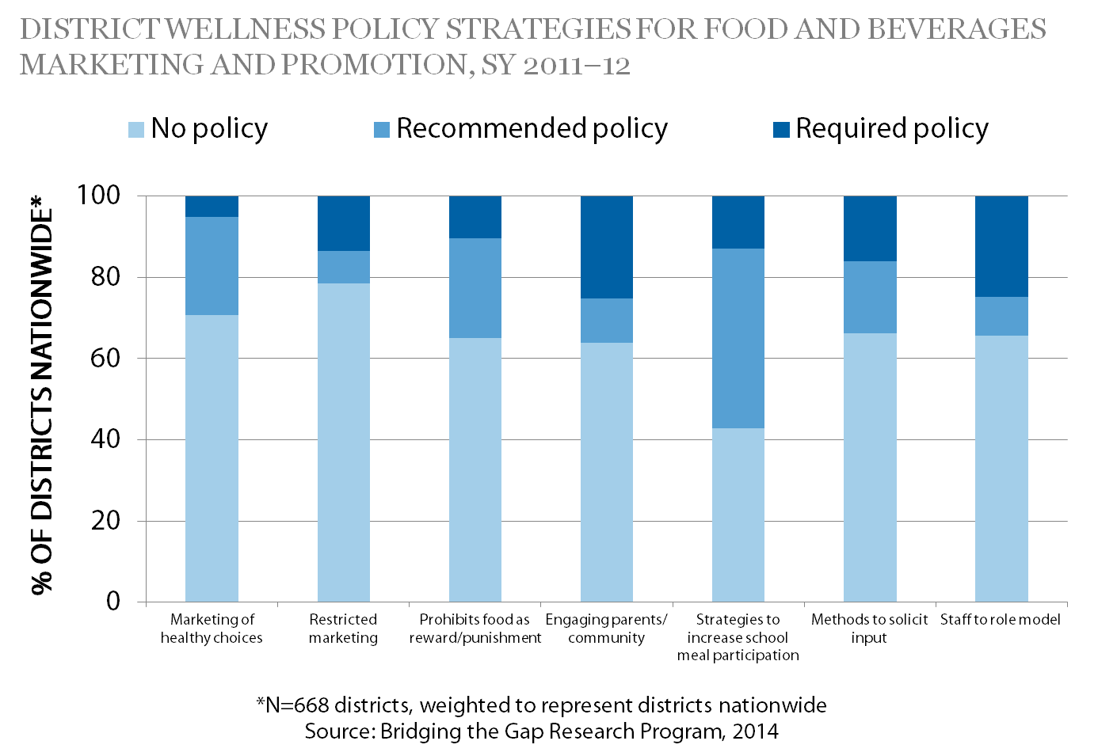
What Actions have School Districts Taken? Food Marketing, Promotion, and Messaging
Notes:
Narrative
School district wellness policies about food marketing, promotion, and messaging in schools can impact students’ eating behaviors.¹ During the 2011–2012 school year, the BTG study found that:
71% of districts had no policy regarding the promotion of healthy food choices in schools.
Only 5% of districts required and fewer than 25% recommended the marketing and promotion of healthy choices (e.g., pricing strategies to encourage healthy items, labeling healthy foods and beverages, posting nutrition education material in the cafeteria).
14% of districts required and 8% recommended restricting the marketing of unhealthful items on school grounds.
10% of districts required and 25% recommended prohibiting food as a reward or punishment for student behavior.
25% of districts required and 11% recommended strategies to engage parents and the community on wellness issues (e.g., sharing wellness and nutrition information on the district website, in school newsletters, or presentations that focus on nutrition and healthy lifestyles).
13% of districts required and 44% recommended strategies to increase participation in school meal programs (e.g., closed campus policies, promotional mailings, breakfast in the classroom, student input on menu selections, and “Grab and Go” or “Fun on the Run” options).
16% of districts required and 18% recommended methods to solicit input from stakeholders by using student satisfaction surveys, taste-testing of new healthy items, and involving students and parents in the selection of competitive foods (i.e., other foods or beverages available outside of the school meals program).
25% of districts required and 9% recommended that staff be encouraged to model healthy behaviors.

Slide 72
Marketing Healthy Food Choices
States can^{1,6-11}
Educate districts and relevant state groups about the elements of a healthy school nutrition environment including the marketing and promotion of healthy foods and beverages
Provide training and technical assistance to districts for revising wellness policies that address the marketing and promotion of foods and beverages
Assist districts with monitoring and reporting on the implementation of wellness policies
Notes:
Narrative:
There are a number of evidence-based strategies and expert recommendation that can help improve marketing of healthy choices to children.^{1,6-11} The following actions can help you implement these strategies and recommendations. See the Resource section at the end of this section for links to documents and Web sites that provide additional information to help these efforts.
States can:
Educate districts and relevant state groups about the elements of a healthy school nutrition environment including the marketing and promotion of healthy foods and beverages.
Provide training and technical assistance to districts for revising wellness policies that address the marketing and promotion of foods and beverages.
Assist districts with monitoring and reporting on the implementation of wellness policies.

Slide 73
Marketing Healthy Food Choices
School districts and schools can^{1,6-11}
Negotiate contracts with vendors to limit the sale and marketing of less nutritious foods and beverages in schools
Promote healthier foods and beverages
Prohibit the use of food as reward or punishment for student behavior, and provide teachers with a list of ideas for alternative nonfood rewards
Conduct an assessment of food and beverage advertising and marketing in schools
Review and revise the wellness policy to address the marketing and promotion of foods and beverages
Encourage staff and parents to model healthy behaviors
Provide the district wellness policy to parents and other stakeholders
Solicit input from students on items to include in the school meals
Notes:
Narrative:
School districts and schools can:
Negotiate contracts with vendors to limit the sale and marketing of less nutritious foods and beverages in schools.
Promote healthier foods and beverages.
Prohibit the use of food as reward or punishment for student behavior, and provide teachers with a list of ideas for alternative nonfood rewards.
Conduct an assessment of food and beverage advertising and marketing in schools.
Review and revise the wellness policy to address the marketing and promotion of foods and beverages.
Encourage staff and parents to model healthy behaviors.
Provide the district wellness policy to parents and other stakeholders.
Solicit input from students on items to include in the school meals.

Slide 74
Resources for slide set accompanying the brief Strategies to Improve Marketing and Promotion of Foods and Beverages at School
USDA Food and Nutrition Service. Local School Wellness Policy. http://www.fns.usda.gov/tn/local-school-wellness-policy.
USDA Healthy Meals Resource System. School Nutrition Environment and Wellness Resources. http://healthymeals.nal.usda.gov/school-wellness-resources.
Bridging the Gap Research. School district wellness policy-related reports and materials. http://www.bridgingthegapresearch.org/research/district_wellness_policies.
The Smarter Lunchroom Movement. Cornell Center for Behavioral Economics in Child Nutrition Programs. http://smarterlunchrooms.org/.
Notes:
Narrative:
This slide lists key resources that provide additional information on the topics covered in this presentation.

Slide 75
Cont’d: Resources for slide set accompanying the brief Strategies to Improve Marketing and Promotion of Foods and Beverages at School
Center for Science in the Public Interest. Fact Sheet: Marketing of low-nutrition foods and beverages in schools http://www.cspinet.org/nutritionpolicy/schoolfoodmarketingfacts.pdf.
California Project LEAN. Captive kids: Selling obesity at schools. An action guide to stop the marketing of unhealthy foods and beverages in school. http://californiaprojectlean.org/doc.asp?id=174&parentid=20.
Rudd Roots Parents. Food Marketing in Schools. http://www.ruddrootsparents.org/food-marketing.
Action for Healthy Kids- Healthy Fundraisers Tip Sheet. http://www.actionforhealthykids.org/storage/documents/parent-toolkit/fundraisersf4.pdf.
Notes:
Narrative:
This slide lists key resources that provide additional information on the topics covered in this presentation.

Slide 76
References for slide set accompanying the brief Strategies to Improve Marketing and Promotion of Foods and Beverages at School
Institute of Medicine. National Research Council. Food Marketing to Children and Youth: Threat or Opportunity? Washington, DC: The National Academies Press; 2005.
Commercial Activities in Schools. Report No.GAO/HEHS-00-156. Washington, DC: General Accounting Office; 2000.
Center for Science in the Public Interest. Food and Beverage Marketing Survey: Montgomery County Public Schools. Washington, DC: Center for Science in the Public Interest; 2008. Available at: http://cspinet.org/nutritionpolicy/MCPS_foodmarketing_report2008.pdf.
California Project LEAN. Food and Beverage Marketing on California High School Campuses Survey: Findings and Recommendations. California: Project LEAN; 2006. Available at: http://www.californiaprojectlean.org/docuserfiles//SchoolMarketingReport2006.pdf.
Molnar A, Garcia DR, Boninger F, Merrill B. A National Survey of the Types and Extent of the Marketing of Foods of Minimal Nutritional Value in Schools. Tempe, AZ: Commercialism in Research Unit; 2006.
Centers for Disease Control and Prevention. School health guidelines to promote healthy eating and physical activity. MMWR 2011;60:1–76.

Slide 77
References for slide set accompanying the brief Strategies to Improve Marketing and Promotion of Foods and Beverages at School
Centers for Disease Control and Prevention. Recommended community strategies and measurements to prevent childhood obesity in the United States. MMWR 2009; 58.
American Academy of Pediatrics. Prevention and Treatment Childhood Overweight and Obesity: Policy Tool. Available at: http://www2.aap.org/obesity/schools_5.html.
Institute of Medicine. Accelerating Progress in Obesity Prevention: Solving the Weight of the Nation. Washington, DC: The National Academies Press; 2012.
Institute of Medicine. Local Government Actions to Prevent Childhood Obesity. Washington, DC: The National Academies Press; 2009.
Institute of Medicine. Nutrition Standards for Foods in Schools: Leading the Way toward Healthier Youth. Washington, DC: The National Academies Press; 2007.

Slide 78
Strategies for Addressing Weight Status Measurement in Schools
July, 2014
Suggested fact sheet citation: Centers for Disease Control and Prevention and Bridging the Gap Research Program. Strategies for Addressing Weight Status Measurement in Schools. Atlanta, GA: U.S. Department of Health and Human Services; 2014.
Notes:
Narrative:
The next several slides will highlight key findings and recommendations from the research brief Strategies for Addressing Weight Status Measurement in Schools.

Slide 79
Brief Purpose
Highlights the extent to which public school districts have included weight status measurement as part of a comprehensive wellness policy
Summarizes the strength scores of wellness policy components by whether the policy requires a weight status provision
Notes:
Narrative:
This brief highlights the extent to which public school districts have included weight status measurement as part of a comprehensive wellness policy, based on a nationally representative sample of district wellness policies from the 2011–2012 school year from the Bridging the Gap (BTG) study.
This brief also summarizes the strength scores of wellness policy components by whether the policy requires a weight status provision.

Slide 80
Some school districts include weight status measurement programs in their wellness policies for both surveillance and screening purposes.^{1,2}
Surveillance Programs
Monitor students’ weight status
Screening Programs
Help identify students at risk of weight-related health problems
Provide parents with health information about their child’s weight status
Notes:
Narrative:
Some school districts include weight status measurement programs in their wellness policies for both surveillance and screening purposes. Surveillance programs allow districts to monitor the percentage of students in their district who are underweight, at a healthy weight, overweight, or obese. Screening programs help identify students at risk of weight-related health problems and provide parents with personalized health information about their child’s weight status. A strong wellness policy can support a child’s health by creating a school environment that promotes activity and good nutrition.

Slide 81
Impact on Health
A strong wellness policy with a weight status measurement provision may^{1,3-5}
Increase awareness of overweight and obesity
Allow students to practice behaviors that promote a healthy weight
Notes:
Narrative:
A strong wellness policy with a weight status measurement provision may increase awareness of overweight and obesity and allow students to practice behaviors that promote a healthy weight.

Slide 82
What do the Experts Recommend?
Weight Status measurement programs
Are not currently identified by CDC as an evidence-based practice to address and prevent childhood obesity
Should be complemented by a strong wellness policy
Districts offering these programs should support parents and children in managing children’s weight.¹
Notes:
Narrative:
Weight status measurement programs are not currently identified by the CDC as an evidence-based practice to addressing and preventing childhood obesity.
These programs should be complemented a strong wellness policy to ensure students receive support through a healthy school environment.
Districts offering weight status measurement programs should support parents and children in managing the children’s weight.¹

Slide 83
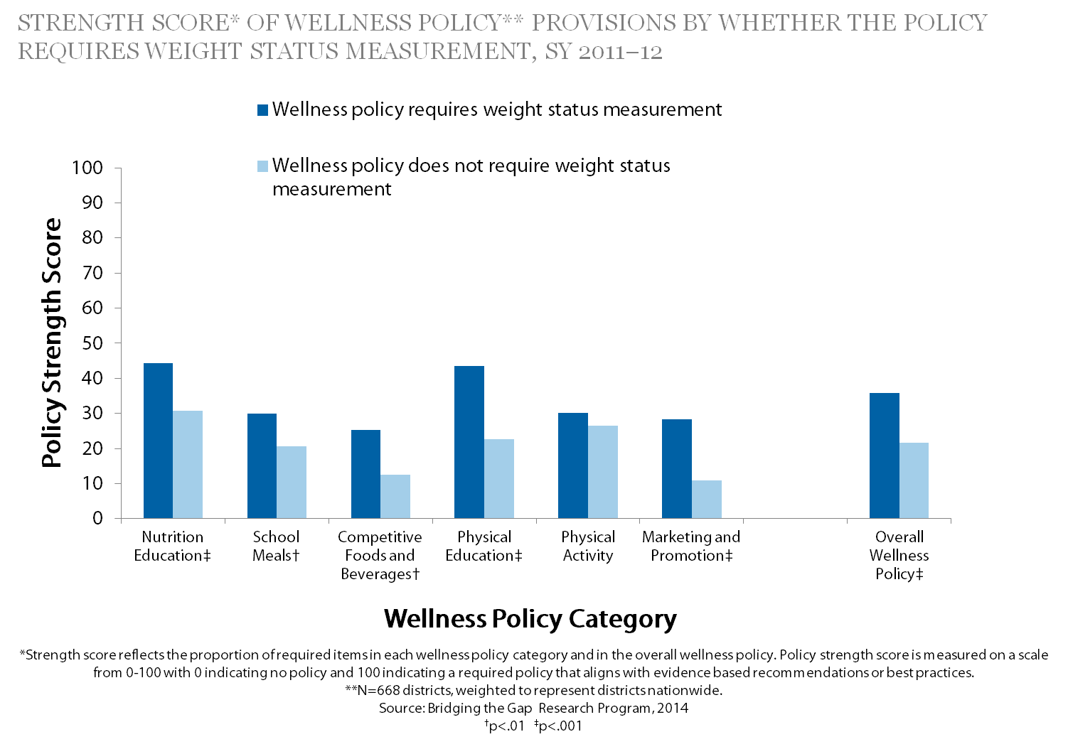
What Actions have School Districts Taken? Weight Status Measurement
Notes:
Narrative:
School districts were identified as having a weight status measurement provision if their wellness policy required schools to measure student body mass index (BMI), body composition, or fitness through FITNESSGRAM®. As part of a comprehensive fitness test, FITNESSGRAM® includes measurement options for student body composition through BMI, skin-fold assessment, or a bioelectric impendence device.
During the 2011–2012 school year, the BTG study found that
10% of school districts had a required weight status measurement provision in their wellness policy.
Wellness policies that required weight status measurement scored significantly higher on overall wellness policy strength (P <.001) than those that did not require weight status measurement.
Individual wellness policy components scored significantly higher on strength of nutrition education (P <.001), school meals (P <.01), competitive foods and beverages (P <.01), physical education (P <.001), and marketing and promotion (P <.01) when the policies included a requirement for weight status measurement.
There were no differences in the strength score of physical activity policy components between districts that did or did not require weight status measurement.

Slide 84
Weight Status Measurement in Schools
States can^{1,6-11}
Offer guidance on whether school districts should pursue weight status measurement, and describe appropriate and inappropriate practices
Provide assistance on implementing a comprehensive set of strategies to address obesity
Notes:
Narrative:
The following evidence-based strategies and expert recommendations provide guidance on how to manage a weight status measurement program.
States can:
Offer guidance on whether school districts should pursue a weight status measurement program, and describe appropriate and inappropriate practices around this strategy.
Work with school districts to procure the necessary equipment to conduct accurate measurements.
Provide technical assistance and professional development opportunities to districts and schools on implementing a comprehensive set of strategies to prevent and reduce obesity, beyond weight measurement programs alone.

Slide 85
Weight Status Measurement in Schools
School districts and schools can^{1,6-11}
Safeguards for weight status screening and surveillance
Support physical activity and nutrition
Introduce the program and obtain parental consent
Train staff
Protect student privacy
Accurately measure height and weight
Use BMI-for-age percentile
Develop efficient data collection
Avoid using results to evaluate student or teacher performance
Evaluate the program
Notes:
Narrative:
School districts and schools can:
Identify the purpose for the weight status measurement program (e.g., surveillance or screening), and consider the pros and cons before engaging in this activity.
Ensure that schools adhere to safeguards to minimize potential harm and maximize potential benefits of the program on promoting a healthy weight.
Introduce the program to school staff and community members.
Obtain parental consent.
Train staff in administering the program; (ideally, implementation will be led by a highly qualified staff member, such as the school nurse).
Establish safeguards to protect student privacy.
Obtain and use accurate equipment.
To accurately classify student weight status, use student height and weight measurements to calculate BMI, and interpret the data by using CDC BMI-for-age growth charts.
Develop efficient data collection procedures (e.g., appropriate number of trained staff, software for data entry, scheduling of measurements).
Avoid using weight status results to evaluate student or teacher performance.
Regularly evaluate the program and its intended outcomes and unintended consequences.
Communicate clearly and respectfully with parents when providing explanation of the weight status screening results, and include appropriate actions and resources for safe and effective follow-up.
Implement comprehensive policies and practices that support physical activity and nutrition.

Slide 86
Weight Status Measurement in Schools
School districts and schools can^{1,6-11}
Additional Screening Safeguards
Share resources for follow-up
Provide parents a clear explanation of results
Notes:
Narrative:
School districts and schools can:
Identify the purpose for the weight status measurement program (e.g., surveillance or screening), and consider the pros and cons before engaging in this activity.
Ensure that schools adhere to safeguards to minimize potential harm and maximize potential benefits of the program on promoting a healthy weight.
Introduce the program to school staff and community members.
Obtain parental consent.
Train staff in administering the program; (ideally, implementation will be led by a highly qualified staff member, such as the school nurse).
Establish safeguards to protect student privacy.
Obtain and use accurate equipment.
To accurately classify student weight status, use student height and weight measurements to calculate BMI, and interpret the data by using CDC BMI-for-age growth charts.
Develop efficient data collection procedures (e.g., appropriate number of trained staff, software for data entry, scheduling of measurements).
Avoid using weight status results to evaluate student or teacher performance.
Regularly evaluate the program and its intended outcomes and unintended consequences.
Communicate clearly and respectfully with parents when providing explanation of the weight status screening results, and include appropriate actions and resources for safe and effective follow-up.
Implement comprehensive policies and practices that support physical activity and nutrition.

Slide 87
Resources for slide set accompanying the brief Strategies for Addressing Weight Status Measurement in Schools
USDA Food and Nutrition Service. Local School Wellness Policy. http://www.fns.usda.gov/tn/local-school-wellness-policy.
Bridging the Gap Research. School district wellness policy-related reports and materials. http://www.bridgingthegapresearch.org/research/district_wellness_policies.
Centers for Disease Control and Prevention. About BMI for Children and Teens. http://www.cdc.gov/healthyweight/assessing/bmi/childrens_BMI/about_childrens_BMI.html.
Centers for Disease Control and Prevention. Body Mass Index Measurement in Schools. Executive Summary. http://www.cdc.gov/healthyyouth/obesity/BMI/pdf/BMI_execsumm.pdf.
Centers for Disease Control and Prevention. Children’s BMI Tool for Schools. http://www.cdc.gov/healthyweight/assessing/bmi/childrens_bmi/tool_for_schools.html.
Notes:
Narrative:
This slide lists key resources that provide additional information on the topics covered in this presentation.

Slide 88
Resources for slide set accompanying the brief Strategies for Addressing Weight Status Measurement in Schools
Centers for Disease Control and Prevention. BMI Percentile Calculator for Child and Teen. http://apps.nccd.cdc.gov/dnpabmi/.
American Heart Association. Policy position statement on body mass index (BMI) surveillance and assessment in schools. http://www.heart.org/idc/groups/heart-public/@wcm/@adv/documents/downloadable/ucm_301789.pdf.
Centers for Disease Control and Prevention. School Health Guidelines to Promote Healthy Eating and Physical Activity. http://www.cdc.gov/healthyyouth/npao/strategies.htm.
Notes:
Narrative:
This slide lists key resources that provide additional information on the topics covered in this presentation.

Slide 89
References for slide set accompanying the brief Strategies for Addressing Weight Status Measurement in Schools
Nihiser AJ, Lee SM, Wechsler H, McKenna M, Odom E, Reinold C, Thompson D, Grummer-Strawn L. Body mass index measurement in schools. J Sch Health. 2007;77(10):651-671.
Chriqui JF, Resnick EA, Schneider L, Schermbeck R, Adcock T, Carrion V, Chaloupka FJ. School District Wellness Policies: Evaluating Progress and Potential for Improving Children’s Health Five Years after the Federal Mandate. School Years 2006–07 through 2010-11. Volume 3. Chicago, IL: Bridging the Gap Program, Health Policy Center, Institute for Health Research and Policy, University of Illinois at Chicago, 2013, www.bridgingthegapresearch.org.
Chomitz VR, Collins J, Kim J, Kramer E, McGowan R. Promoting healthy weight among elementary school children via a health report card approach. Arch Pediatr Adolesc Med. 2003;157(8);765-772.
Phillips MM, Raczynski JM, West DS, Pulley L, Brusac Z, Gauss CH, Walker JF. Changes in school environments with implementation of Arkansas Act 1220 of 2003. Obesity. 2010;18(Suppl 1):S54-S61.
University of Arkansas for Medical Sciences, Fay. W. Boozman College of Public Health. Year Seven Evaluation: Arkansas Act 1220 of 2003 to Combat Childhood Obesity. Little Rock, AR: University of Arkansas for Medical Sciences; 2011. Available at: http://publichealth.uams.edu/files/2012/06/COPH-Year-7-Report-Sept-2011.pdf.
Crawford PB, Woodward-Lopez G, Ikeda JP. Weighing the Risks and Benefits of BMI Reporting in the School Setting. Berkeley, CA: Center for Weight and Health; 2006. Available at: http://cwh.berkeley.edu/sites/default/files/primary_pdfs/BMI_report_cards_0.pdf.

Slide 90
References for slide set accompanying the brief Strategies for Addressing Weight Status Measurement in Schools
Institute of Medicine. Prevention Childhood Obesity: Health in Balance. Washington, DC: The National Academies Press; 2005.
Haller EC, Petersmarck K, Warber JP, eds. The Role of Michigan Schools in Promoting Healthy Weight. Lansing: MI: Michigan Department of Education; 2001.
Arkansas BMI Task Force, Arkansas Center for Health Improvement, University of Arkansas for Medical Sciences, Arkansas Department of Education. A Training Manual for Height and Weight Assessment. 2010. Little Rock, AR: Arkansas Center for Health Improvement. Available at: http://www.achi.net/BMIContent/Documents/101007_Height_and_Weight_Measurement_Training_Manual1with_revisions.pdf.
Missouri Department of Health and Senior Services. Guidelines for Growth and Screening in Missouri Schools. Jefferson City, MO: Missouri Department of Health and Senior Services; 2005. Available at: http://health.mo.gov/living/families/schoolhealth/pdf/GuidelinesForGrowth.pdf.
Pennsylvania Department of Health. Procedures for the Growth Screening Program for Pennsylvania’s School-Age Population. Harrisburg, PA: Pennsylvania Department of Health. Available at: http://www.chadphila.org/files/CHADassets/pdf/health/d1.pdf.

Slide 91
Local School Wellness Policies: Where do They Stand and What Can You Do?
July, 2014
Suggested brief citation: Centers for Disease Control and Prevention and Bridging the Gap Research Program. Local School Wellness Policies: Where Do They Stand and What Can You Do? Atlanta, GA: U.S. Department of Health and Human Services; 2014.
Notes:
Narrative:
The next several slides will highlight the research brief Local School Wellness Policies: Where do They Stand and What Can You Do?

Slide 92
Brief Purpose
Pulls together highlights from other briefs in the series relative to
Nutrition education and promotion
Nutrition standards
Physical Activity
Physical education
Provides data for topics not covered in other briefs
Nutrition standards for school meals
Stakeholder involvement
Wellness policy monitoring, evaluation, and reporting
Notes:
Narrative:
Local school wellness policies (i.e., wellness policies) provide an opportunity to create and support a healthy school environment, promote student health, and reduce childhood obesity. The purpose of the brief “Local School Wellness Policies: Where do They Stand and What Can You Do?” is to provide an overview of the actions that have been taken by school districts (and in the case of recess, states) for the wellness policy components that are covered in detail in the individual topic-specific briefs, including:
Nutrition education and promotion (refer to slide decks for briefs: “Strategies for Creating Supportive School Nutrition Environments” and “Strategies to Improve Marketing and Promotion of Foods and Beverages at School”)
Standards for competitive foods and beverages (refer to slide deck for brief: “Strategies for Creating Supportive School Nutrition Environments” )
PA outside of physical education (PE) (refer to slide decks for briefs: “Strategies for Supporting Quality Physical Education and Physical Activity in Schools” and “Strategies to Support Recess in Elementary School”)
PE (refer to slide deck for brief: “Strategies for Supporting Quality Physical Education and Physical Activity in Schools” )
This brief also provides data, which will be presented in the next three slides, for wellness policy components that are not covered in the other six briefs, which are:
Nutrition standards for school meals
Stakeholder involvement
Wellness policy monitoring, evaluation, and reporting.

Slide 93
What Actions Have School Districts Taken? Nutrition Standards for School Meals, SY 2011-2012
Approximately 85% of districts included an assurance in the wellness policy that school meals meet federal standards.
Nearly 51% of districts required participation in the School Breakfast Program.
Notes:
Narrative:
Wellness policies are required to include an assurance that school meals at least meet the federal standards.³ Districts may also include other requirements related to school meals. During the 2011–2012 school year,
Approximately 85% of districts included an assurance in the wellness policy that school meals meet federal standards.
Nearly 51% of districts required participation in the School Breakfast Program.

Slide 94
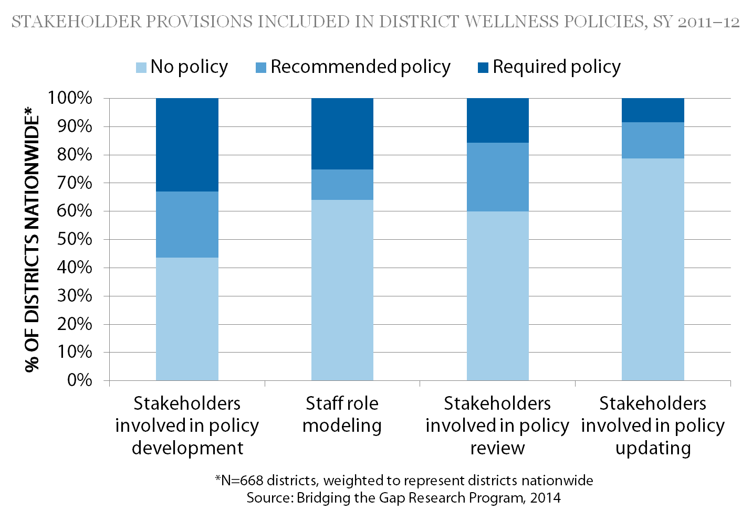
What Actions Have School Districts Taken? Stakeholder Provisions
Notes:
Narrative:
The Healthy, Hunger-Free Kids Act of 2010³ included provisions to increase stakeholder involvement implementing, monitoring and reporting about wellness policies. Policies can also encourage district staff members, a key stakeholder group, to model healthy behaviors as a part of daily life.
During the 2011–2012 school year, few district policies required stakeholder involvement

Slide 95
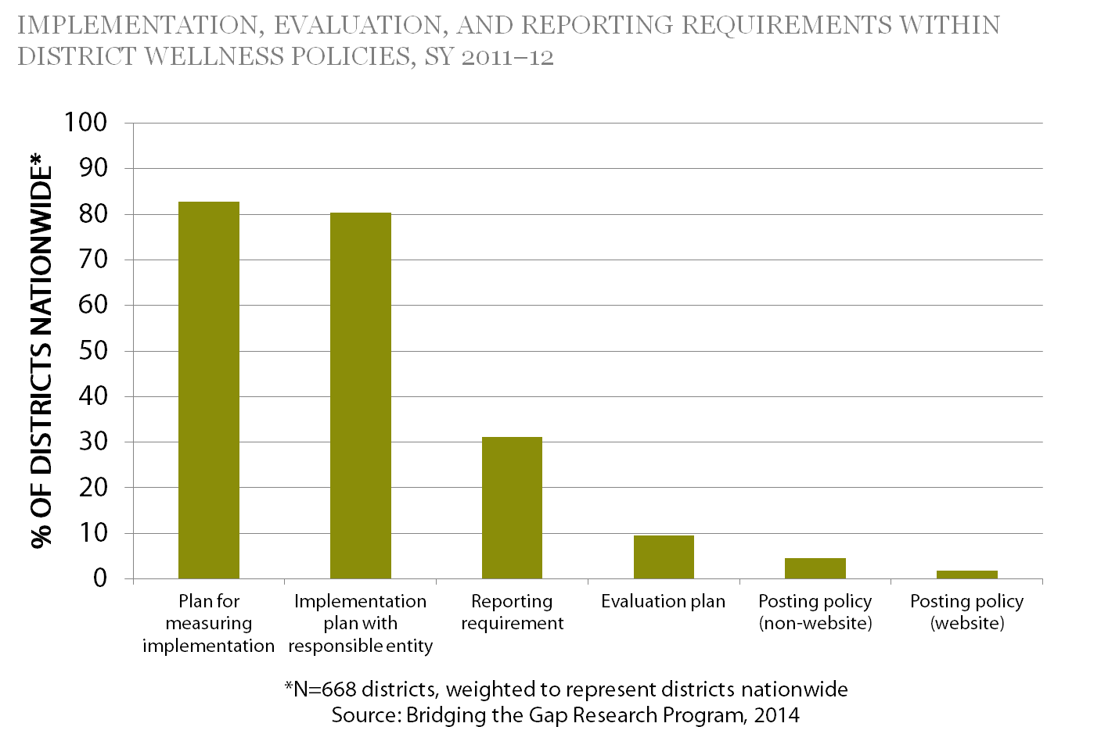
What Actions Have School Districts Taken? Implementation, Evaluation, and Reporting
Notes:
Narrative:
The Healthy, Hunger-Free Kids Act of 2010³ included new language to require that districts periodically measure and report on policy implementation, compliance, and progress. During the 2011–2012 school year,
Although the majority of districts required implementation plans and assigned implementation responsibility for implementation, few required reporting, evaluating, or making the policies publicly accessible such as on the district Web site (Figure 4).
When specified, implementation review typically was required every 1–3 years and annual reporting was the most common reporting timeframe.
48% of districts required an ongoing health advisory or wellness committee.

Slide 96
Resources for slide set accompanying the brief Local School Wellness Policies: Where Do They Stand and What Can You Do?
USDA Food and Nutrition Service. Local School Wellness Policy. http://www.fns.usda.gov/tn/local-school-wellness-policy.
USDA Healthy Meals Resource System. School Nutrition Environment and Wellness Resources. http://healthymeals.nal.usda.gov/school-wellness-resources.
Bridging the Gap Research. School district wellness policy-related reports and materials. http://www.bridgingthegapresearch.org/research/district_wellness_policies.
Notes:
Narrative:
This slide lists key resources that provide additional information on the topics covered in this presentation.

Slide 97
For More Information
Centers for Disease Control and Prevention (CDC)
http://www.cdc.gov/.
Bridging the Gap Research Program (BTG)
http://www.bridgingthegapresearch.org/.
The mark ‘CDC’ is owned by the US Dept. of Health and Human Services and is used with permission. Use of this logo is not an endorsement by HHS or CDC of any particular product, service, or enterprise.

